Slide 1

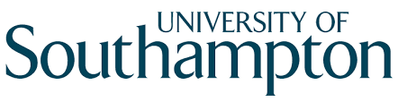
How does engagement with online mutual aid support recovery from problematic alcohol use?
Sophia Chambers
PhD student, sec1n14@soton.ac.uk

Slide 2
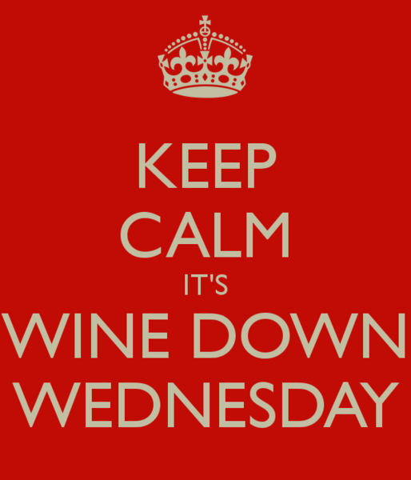
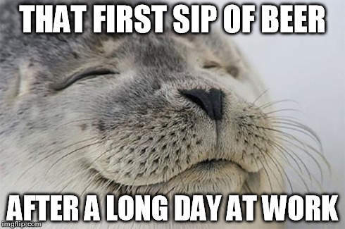

Slide 3
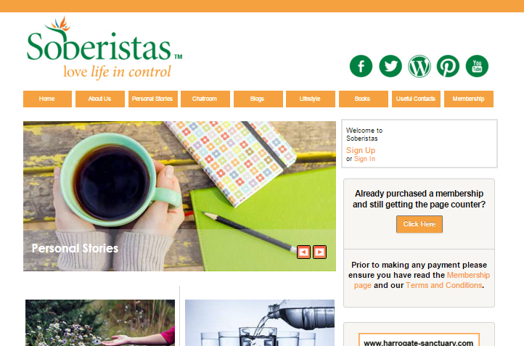

Slide 4
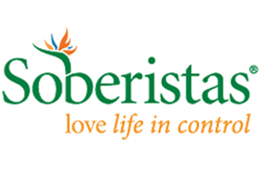
BLOGS
PERSONAL STORIES
BOOK CLUB
WEBINARS
ONLINE CHATROOM
ASK THE DOCTOR

Slide 5
1828 members &
≈2000 browsers
438 completed survey
PHASE 1

Slide 6


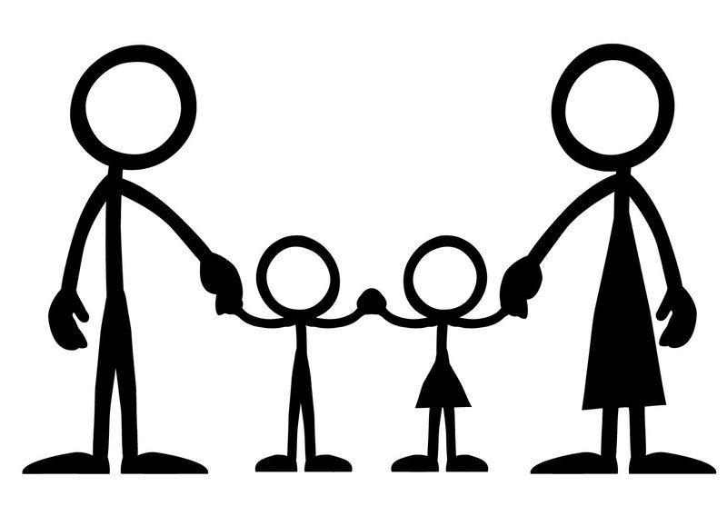
6% 94%
60%
42% between
45 – 54 years
50%
Sinclair et al. (2016), Alcohol & Alcoholism

Slide 7
1828 members &
≈2000 browsers
438 completed survey
31 interviewed
(28 from survey)
PHASE 1
PHASE 2

Slide 8
Maximum Variation Sample
Characteristic | My sample
Gender
Age
Current alcohol use
Treatment history
Time with Soberistas
Membership status

Slide 9
Maximum Variation Sample
Characteristic | My sample
Gender | 6 male / 25 female
Age | Range 28 – 74 years
Current alcohol use | 7 Currently drinking 24 Alcohol-free (2 weeks – 5 years)
Treatment history | 13 None / 13 Previous 5 currently using Soberistas alongside something else
Time with Soberistas | Range 1 week – 3 years
Membership status | 24 Subscription-paying 4 Ex-members / 3 Browsers

Slide 10
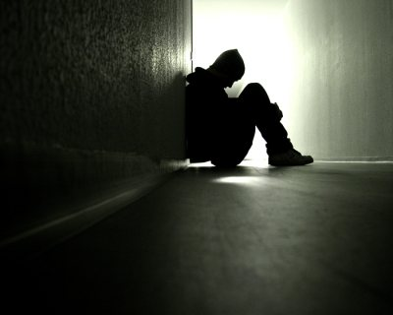
A hidden identity

Slide 11
A hidden identity
“I had this hidden secret that I was a drinker. I presented myself to the world as efficient, a coper...there’s the pride, the secretiveness of it, you're presenting one side but in actual reality, that's not what you're really like.”
(Sarah, Member, 3-months alcohol-free)

Slide 12
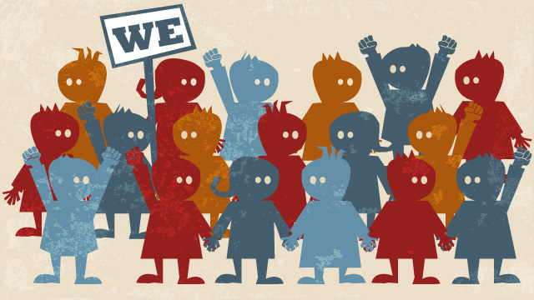
A hidden identity
“It just helped me to not feel really crap about myself because I could see that other people had this problem…other women with children and jobs…not necessarily down and outs.”
(Abby, Member, currently drinking)

Slide 13
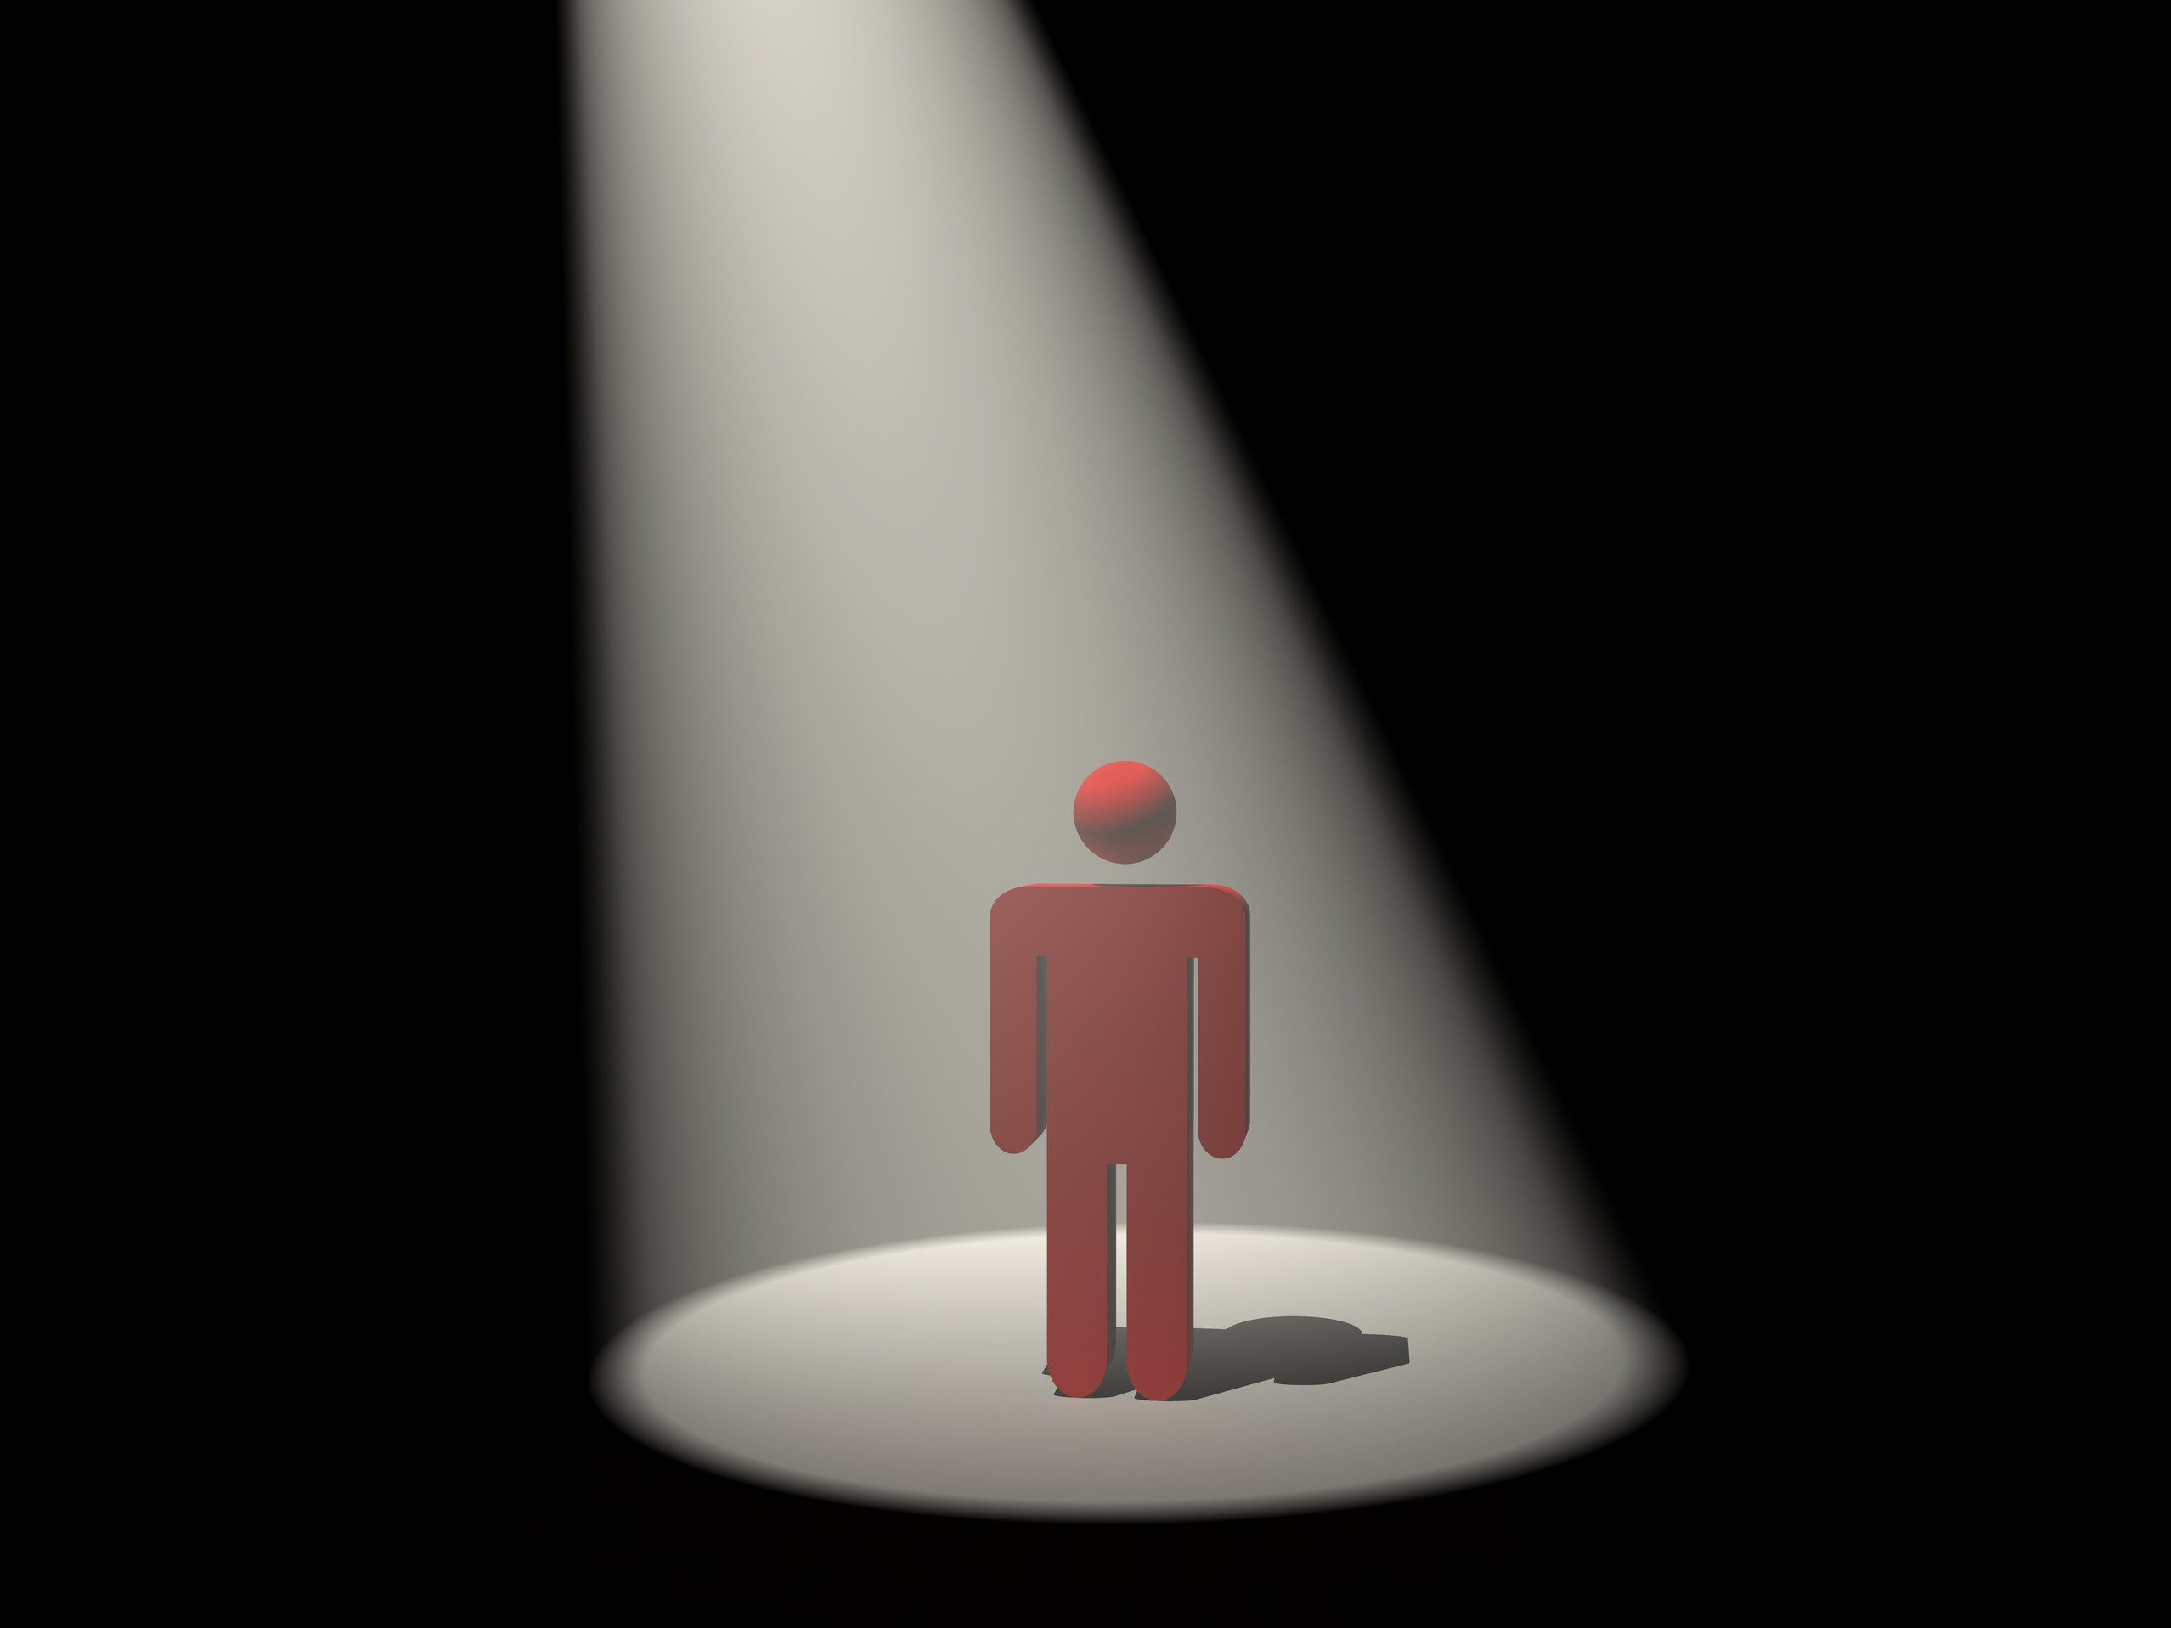
A hidden identity
“You want to keep a lid on it so much, you want to contain it yourself…it’s a huge comfort that you’re shrouded, there’s no spotlight on your real life.”
(Michelle, Member, 5-months alcohol-free)

Slide 14
The Soberistas Ethos

Slide 15
The Soberistas Ethos
“The first night I was on…the first message I got was, “how long are you AF?”
Well I didn’t know what AF was, I was actually too embarrassed to ask what AF was…
I kind of worked it out myself, well I thought that must be ‘alcohol-free’.”
(Kevin, Member, 2-years alcohol-free)

Slide 16
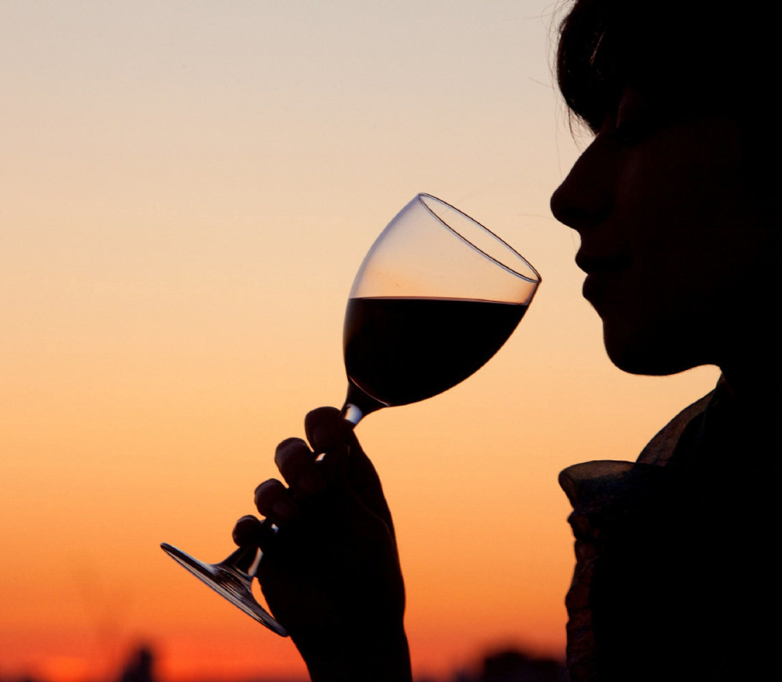
The Soberistas Ethos
“I said I was thinking of having a drink – I got lots of support, but I also got lots of aggressive comments, and then when I did drink I blogged about it but it got really quite nasty.”
(Angela, Member, currently drinking)

Slide 17
The Soberistas Ethos
“I fundamentally did not, and still do not believe that I was ‘an alcoholic’”
(Hayley, ex-member, 3-years alcohol-free)
“‘Alcoholic’ tends to stir up discomfort in people…if I think of an alcoholic I would think of someone who would engender pity, and that’s not what it is about…It’s about the celebration of not drinking.”
(Yasmin, ex-member, 18-months
alcohol-free)

Slide 18
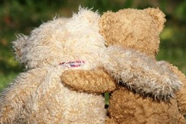
Accountability as a mechanism of change

Slide 19
Accountability as a mechanism of change
“Once you create an ‘identity’, and you put yourself out there on blogs or commenting on other people's blogs, you're almost a little bit, in your heart of hearts –accountable.” (Michelle, Member, 5-months alcohol-free)

Slide 20
Accountability as a mechanism of change
“When I was going through a moderating phase, I didn’t really look at the site…I didn’t really want to engage. Using the site is for me to not drink…when I am drinking I kind of don't see the point.”
(Kimberley, member, 2-months alcohol-free)

Slide 21
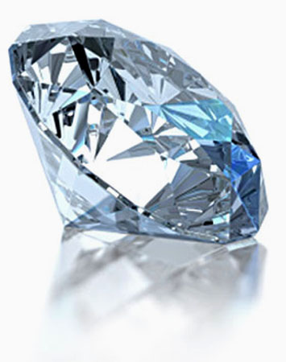
Tracy & Trethewey (2005)

Slide 22
“I just found it easier to talk about the whole subject anonymously…it becomes terribly easy to talk about it in a third person almost, as if you’re somebody else, and I found that very helpful. I found it much easier to admit that I was sitting there at 9 o’clock in the morning with a bottle of vodka in front of me.”
(Ben, member, 3-years alcohol-free)

Slide 23
Building an “authentic” identity
“I am secure in my sobriety”
(Caroline, member, 3-years alcohol-free)
“I am my authentic self not drinking.”
(Yasmin, ex-member, 18-months alcohol-free)

Slide 24
Building an “authentic” identity
“I thought I’m going to be open, known by my own name…and I was going to stand up and be counted for –
give a face to this hidden group.”
(Jenny, member, 5-years alcohol-free)
“I am secure in my sobriety”
(Caroline, member, 3-years alcohol-free)
“I am my authentic self not drinking.”
(Yasmin, ex-member, 18-months alcohol-free)

Slide 25
Special thanks to my participants, staff at Soberistas, and my supervisors:
Dr Julia Sinclair, Professor David Baldwin & Dr Krysia Canvin
Funding: Wessex Academic Health Science Network, in partnership with an enterprise grant awarded to Soberistas for independent evaluation of the site.
Any questions?

