Slide 1
Noriko Cable, PhD
Senior Research Fellow
n.cable@ucl.ac.uk

Slide 2
The role of early cognitive ability and traits on patterns of adult problem alcohol use: Evidence from the 1958 British Birth Cohort Study
Noriko Cable¹, Linda Ng Fat¹, Gareth Hagger-Johnson¹, Steven Bell¹, Nicola Shelton¹, Annie Britton¹, Yuki Sato²
¹Alcohol Research Interest Group, University College London, UK
²Research Institute of Environmental Health, Ministry of Environmental Health, Japan

Slide 3
Background
Early determinants for adult problem alcohol use
  Genetics, early exposure to alcohol use
  Cognitive abilities at earlier age
    Intelligence worked opposite to women
  Social disinhibition in adolescence
    Associated with adult alcohol use and misuse

Slide 4
Research aim
To address how early cognitive ability and internal and external traits would determine the patterns of problem alcohol use in adulthood.

Slide 5
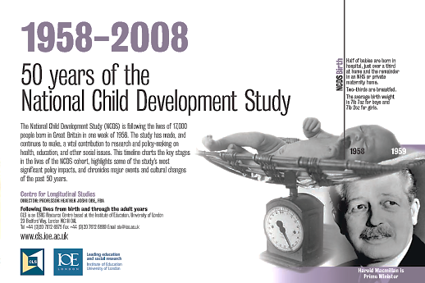
Methods
Participants
  National Child Developmental Study (NCDS)

Slide 6
  Targeting British Residents, born during one week in 1958
    Based on the Perinatal Mortality Survey
    To understand how physical, cognitive, behavioural, psychosocial development take place
    How development, environments, behaviours would affect human health

Slide 7
  Followed regularly since birth, age 7, 11, 16, 23, 33, 42, 46, 50, 55 (2013) and ongoing
  Data accessible via the UK data archive
  Available cases
    Men= 3231, Women=3432

Slide 8
Methods
Childhood traits (External vs. Internal)
  Used scores on the 4 subscales from the Bristol Social Adjustment Guide, administered at age 11
    Reported by a CM’s teacher
    External traits: Hostility
      Adults & Children
    Internal traits: Anxious about being accepted by:
      Adults & Children
    Scores deciled
      Cut off at the highest 10% (=poorest)

Slide 9
Childhood cognition
  A total score on the General Ability Test, administered at age 11
    Indicating children’s verbal and non-verbal skills

Slide 10
Adult problem alcohol use (Outcome)
  Obtained at age 33/42 via CAGE (scoring 2 or more)
  Obtained at age 50 via AUDIT (Scoring 8+, hazardous & possible dependence)
  Derived a variable by combining responses:
    Not problem use (reference), Ex-problem use (33/42 only), Current problem use (Age 50 only), and Continuous problem use (Age 33/42 – Age 50)

Slide 11
Confounders
    Father’s social position
      Registrar-General’s Social Class
    Maternal education
      Stayed beyond the minimum leaving age or not

Slide 12
Analysis
  Multinomial regression analysis
    No problem use as a reference category

Slide 13
Findings

Slide 14
Proportion of types of adult problem alcohol use by gender
%

Slide 15
Proportions of external traits (hostility toward adults/children) at age 11 by gender
%

Slide 16
Proportion of internal traits (anxious about being accepted by adults/children) by gender
%

Slide 17
Relative Risk Ratio (RRR) obtained by multinomial logistic regression for adult problem alcohol use after adjusting for social position of origin and maternal education (Men=3231)
RRR
*
*
*
* <0.05, **<0.01, *** <0.001

Slide 18
Relative Risk Ratio (RRR) obtained by multinomial logistic regression for adult problem alcohol use after adjusted for social position of origin and maternal education (Women=3432)
RRR
*
* <0.05, **<0.01, *** <0.001

Slide 19
Discussion
Anxiousness being accepted by adults (=internal) showed longitudinal associations with:
  Continuous problem alcohol use in men and women.
Boys’ hostility toward adults (=external)
  Problem use in midadulthood

Slide 20
Discussion (cont’d)
Timing of problem alcohol use
  Contextual?
    Past problem use (early middle adulthood)
      Outgrowing of problems socialising with:
        Adults (men)
        Peer (women)
    Continuous problem use
      Tapped into social desirability from earlier time
  Further studies are needed.

Slide 21
Limitations
Measurements on problem alcohol use
  CAGE vs. AUDIT
Attrition
  Multiple imputation

Slide 22
Implications for population health
Alcohol education programs at school can:
  Address socialization skills with peer without drinking
  Offer emotional support for boys

Slide 23
Thank you for listening.
Do you have any questions?
E-mail: n.cable@ucl.ac.uk

