Slide 1
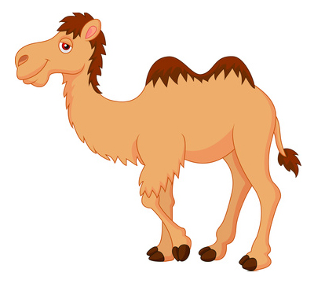
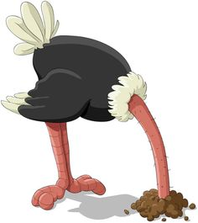
Camels &
Ostriches
Understanding nuances in recovery journeys
Sophia Chambers - University of Southampton

Slide 2
T1
T2
Hospital based observational cohort study (baseline)
6-month follow-up of all participants
QUALITATIVE

Slide 3
n = 9
Lost to follow-up at 6 months
n = 141
Completed baseline interview
n = 121 completed follow-up interview
n = 26 participated in qualitative interview
n = 132
Followed-up at 6 months
n = 144 Participants recruited
n = 11 Deceased
n = 3
Withdrew consent

Slide 4
<6% of those with alcohol dependence receive specialist treatment per year (Drummond, 2005)
Reliance on pre- / post- intervention studies
Research focus on those in specialist treatment settings might fuel binary beliefs about alcohol problems

Slide 5
£3.5 billion per year
78% hospital-based care
115% increase in alcohol-related hospital admissions 2003 – 2013
6 MONTHS LATER
HOSPITAL

Slide 6
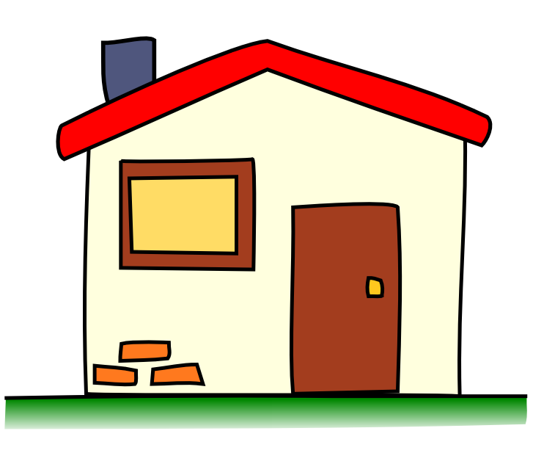
Baseline Demographics
47% sick/disabled
19% retired
95%
White
British
51% living alone
71% 29%
Mean age:
50.8 years
50% secondary
31% college

Slide 7
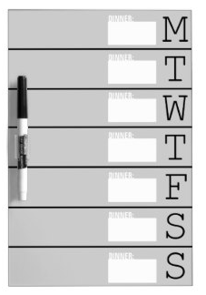
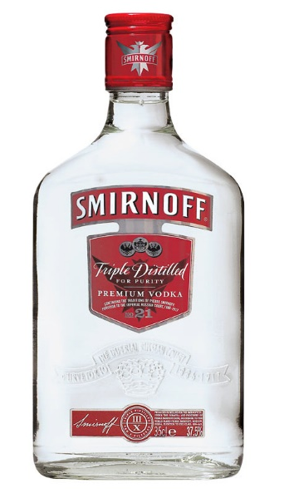
Drinking Profile
7/7 drinking days for 67.4%
Weekly units: 140.6
(range 0 – 576)
20+ AUDIT
88.7%
42.6%
35.5%
17% in treatment

Slide 8
My Self
Pictorial Representation of Illness and Self Measure (PRISM; Buchi et al, 1999)

Slide 9
“Social drinker”
Build up to hospital
My Self
NOW: No disc at all

Slide 10
“I’m an ostrich I suppose…put my head in the sand. If I’m not thinking about it then…well, it’s history, past tense.”

Slide 11
Some people I have spoken to say they will always be an alcoholic even if they have stopped drinking…
“Oh no I don’t get that. That was just something I might, might, have been back then, but it doesn’t mean that stays with me forever. It’s like with my cancer, I had cancer then, I’m not cancerous now.
Anyway, I don’t keep thinking about drink…what I will think about is that time in hospital…the minute I came out, I left all of that in there. It was a big trauma that happened, hospital was the cross roads, and then I came out and went in a different direction. I don’t feel the need to remind myself of it all the time…well not of my drinking anyway.”

Slide 12
My Self
Small disc: sobriety
Medium disc: “dry drunk” - NOW
Large disc: when drinking

Slide 13
“I have camels all around my house, I have a broach of a camel, I have a stuffed toy camel in my car, I have a photo in my wallet.
I think to myself, if that camel can go a day without water, I can go a day without a drink.”

Slide 14
“I’ll be an alcoholic for the rest of my life but the bouts of illness come and go depending on whether I’m sober or not…If I don’t call myself an alcoholic, I am denying what I am.
I could have gone another 30 years without drink but I would have still died an alcoholic.”

Slide 15
My Self
NOW: No disc at all

Slide 16
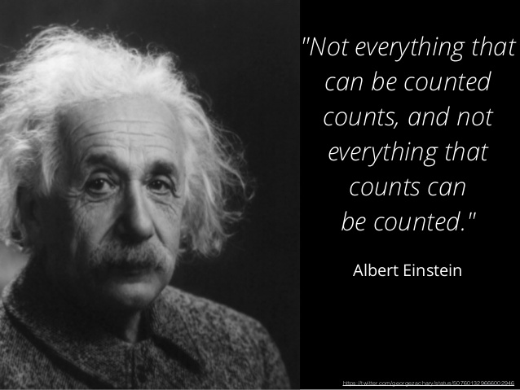

Slide 17
Thank you!
Any questions?
sec1n14@soton.ac.uk

