Slide 1
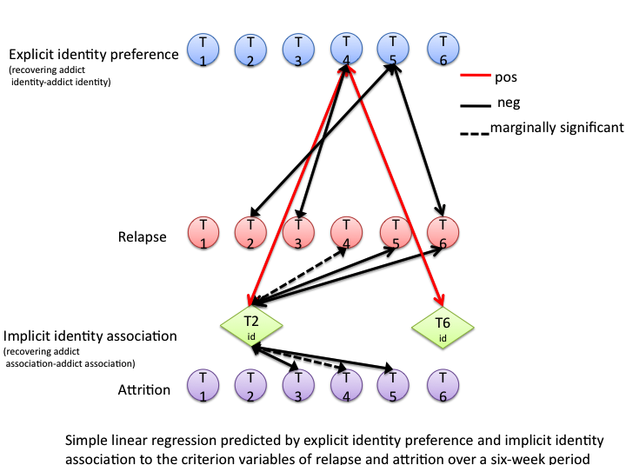
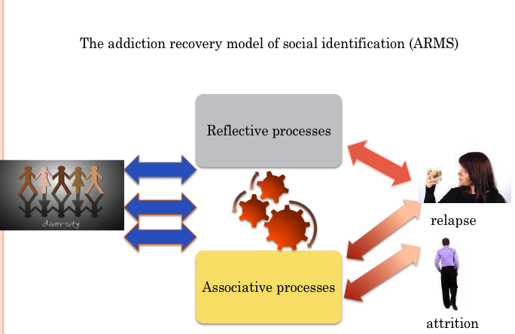
Introducing The addiction recovery model of social identification (ARMS) as evidenced in a six-week prospective study Sarah A Buckingham, Daniel Frings, & Ian P Albery, London South Bank University
Implicit
Explicit
Aims: To explore how implicit and explicit measurement outcome of differentiation between a social identity of recovery addict (ingroup) compared to addict (outgroup) might impact relapse and attrition rates over a six-week period
Design: A prospective six-week study with explicit identity preference and implicit identity association (recovering addict - addict) as predictors to relapse and attrition rates as criterion variables.
Setting: County based alcohol and drugs charity.
Participants: Thirty-Seven service-users attending ‘recovery’ groups.
Measurement: Personalised Single Target Association Test (ST-IAT) (T2,T6) (Wigboldus,Holland, & van Knippenberg,2006) and self-report questionnaire (T1-T6)
Findings: Implicit identity association toward the recovery addict identity T2, significantly predicted reduced levels of relapse with greater variance than explicit identity preference for the recovering addict identity T2, which was not significant in the model. These results were replicated for relapse T4, T5 and T6. Implicit identify association toward the addict identity significantly predicted attrition at T3 and T5.
Conclusions: The addiction recovery model of social identification (ARMS) developed from this work may better inform how positively distinct social identities of addiction and recovery at both implicit and explicit levels may direct and moderate behaviour. Treatment implementation that considers this perspective may therefore be more effective.
buckins3@lsbu.ac.uk
References. Wigboldus, D. H. J., Holland, R. W., & van Knippenberg, A. (2006). Single target implicit associations. Unpublished manuscript.

