Slide 1
The use of social media within an isolated network of people who inject drugs
SSA conference November 2016
Ryan Buchanan
NIHR CLAHRC Research fellow
Hepatology Registrar
University of Southampton

Slide 2
Disclosures
Gilead Fellowship 2014
Gilead Research grant 2015
Abbvie preceptorship fellowship 2016-2018

Slide 3
Background & rationale
Hepatitis C is a leading cause of mortality world-wide¹
Hepatitis C is now easily cured
Many cases are undiagnosed²
Most of these undiagnosed cases are PWID and people who used to inject drugs²
The treatment of PWID will have the greatest impact on disease prevalence³
1. Stanaway et al. Lancet. 2016
2. Public health England. Report on Hepatitis C. 2015
3. Innes et al. Gut. 2015

Slide 4
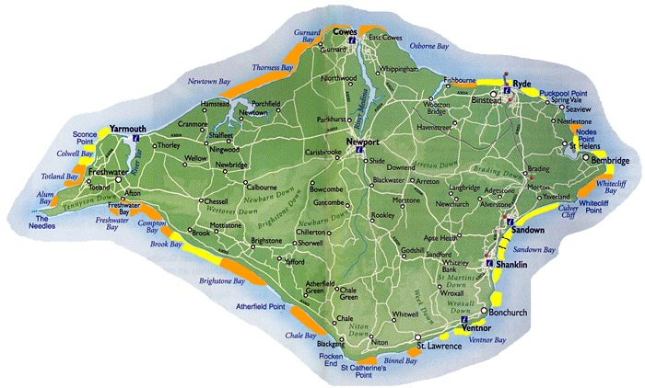
Background & rationale
Isle of Wight

Slide 5

Background & rationale
Known cases of chronic HCV in Isle of Wight residents
2003-2014

Slide 6
Background & rationale
110 active chronic infections
A few had died and been successfully treated

Slide 7

Background & rationale
200 missing chronic infections!
Could social media help us?

Slide 8
Background & rationale
Previous experience on using physical social network to facilitate harm reduction behaviours^{4,5}
Not known whether or how PWID use social media
Limited data on the feasibility of using social media for health promotion in other contexts⁶
4. Friedman, et al. International Journal of Drug Policy. 1997
5. Booth, et al. Am J Public Health. 2011
6. Laranjo, et al. J Am Med Inform Assoc. 2014
Notes:
Reference here is a SR and metaanalysis of online social network services and health related behaviour change, a number of RCTs looking at weight loss in a range of populations…one quasi-experimental study was in MSM and used online peer led intervention to encourage HIV tetsing. The article was published in 2014

Slide 9
Research question
How are PWID connected through social media within a physical social network?

Slide 10
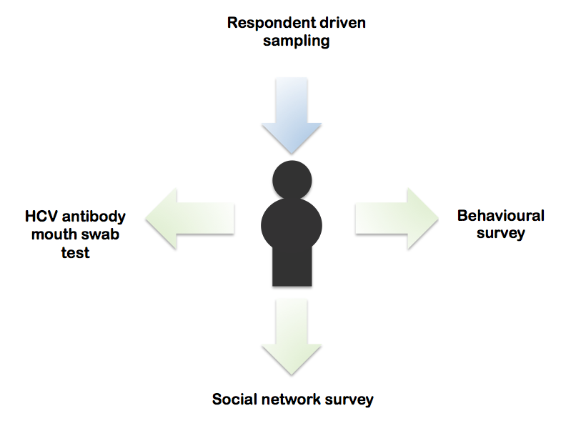
Method
Method
7. Greene. Educ Eval Policy Anal. 1989
8. Hollstein, et al. Mixed Methods Social Networks Research. 2014

Slide 11
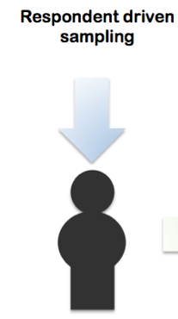
Sampling and recruitment
Respondent driven sampling
  Conceived in 1997
  Recognised method for sampling hard to reach populations
  Can provide representative sample in absence of sampling frame⁹
9. Heckathorn DD. Sociol Methodol. 1997

Slide 12

Seed
Wave 1
Wave 2

Slide 13
Formative research
Target population
16 semi-structured interviews with purposive selection of PWID
1 focus group with drug support centre staff
Seed selection
Survey venue
Survey incentives
Recruitment coupon design

Slide 14
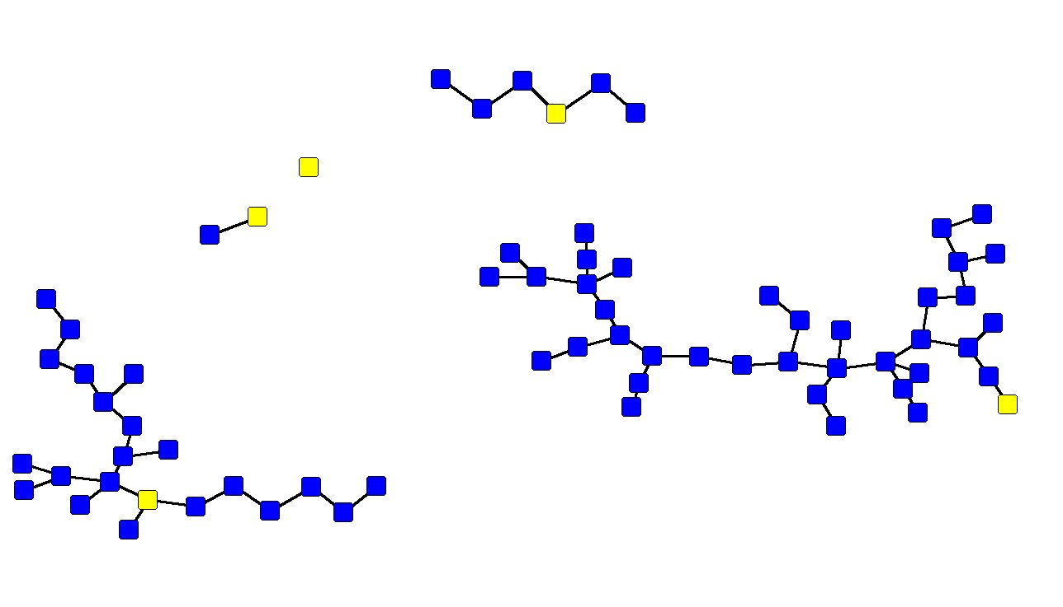
Sampling results
N=69

Slide 15




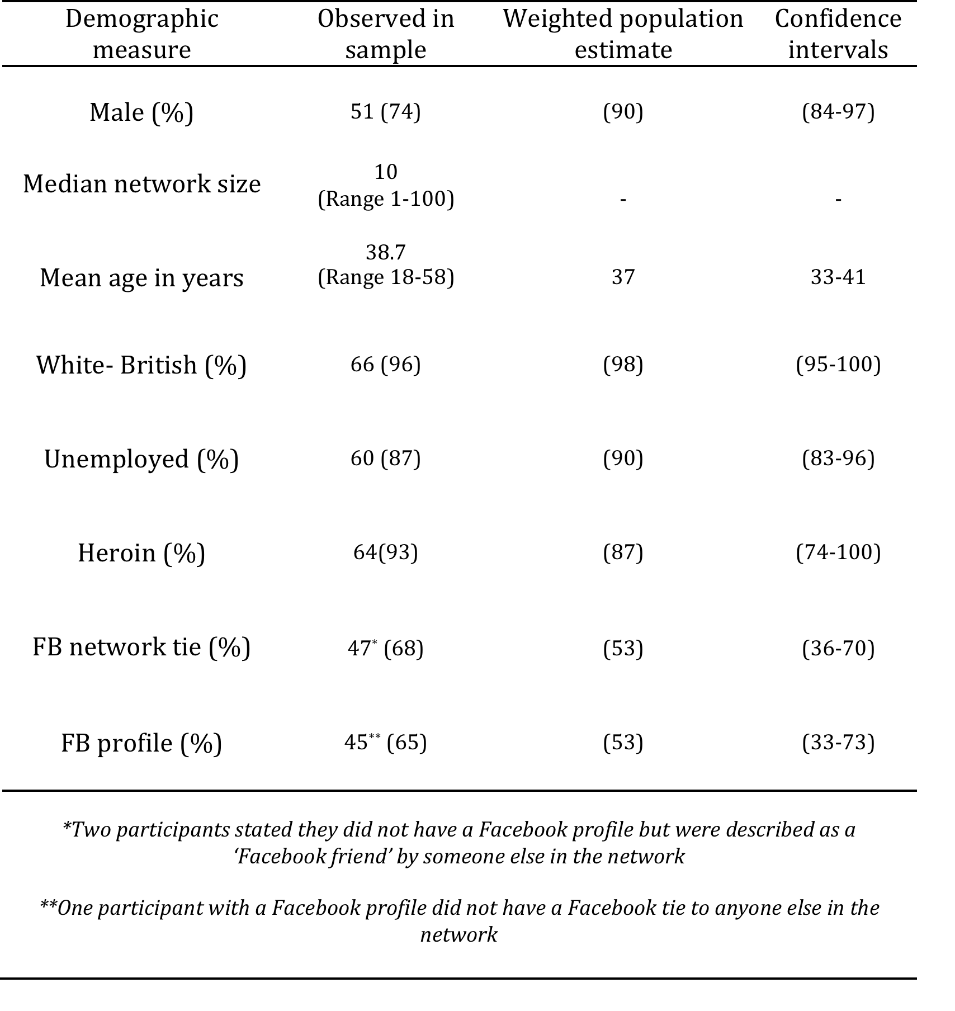
Population demographic estimates

Slide 16

Social network survey – data collection
TaR40FCo
GC38MR
Match!
GC38MR
Initials
Age
Gender
Home town
16

Slide 17
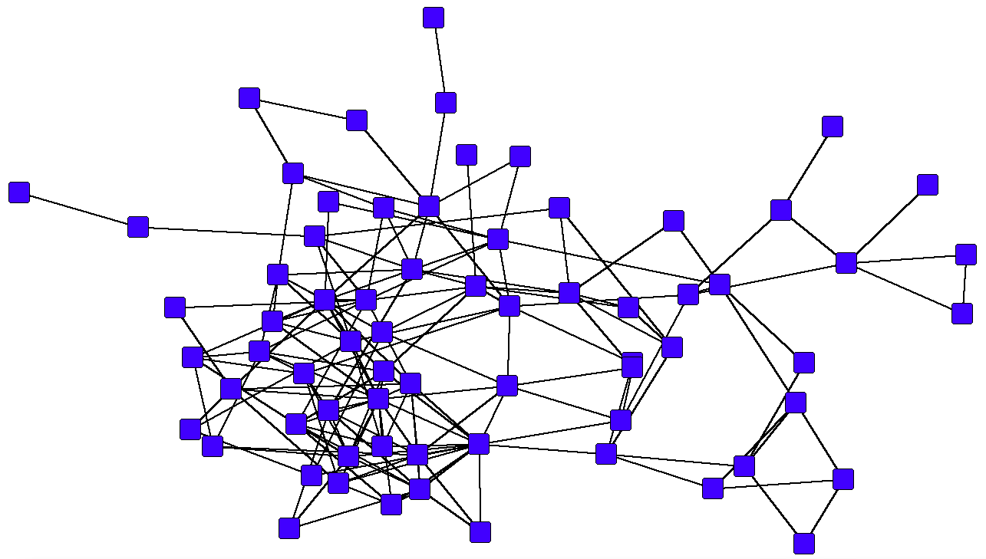
Survey network

Slide 18
Social network survey – network creation
TaR40FCo
?
?
?
Match!
TaR40FCo
TaR40FCo
GC38MR
?
GC38MR
?
?
18
Notes:
Access to participants hidden from researchers

Slide 19
Survey results – network creation
Non-Survey participant
Survey participant

Slide 20
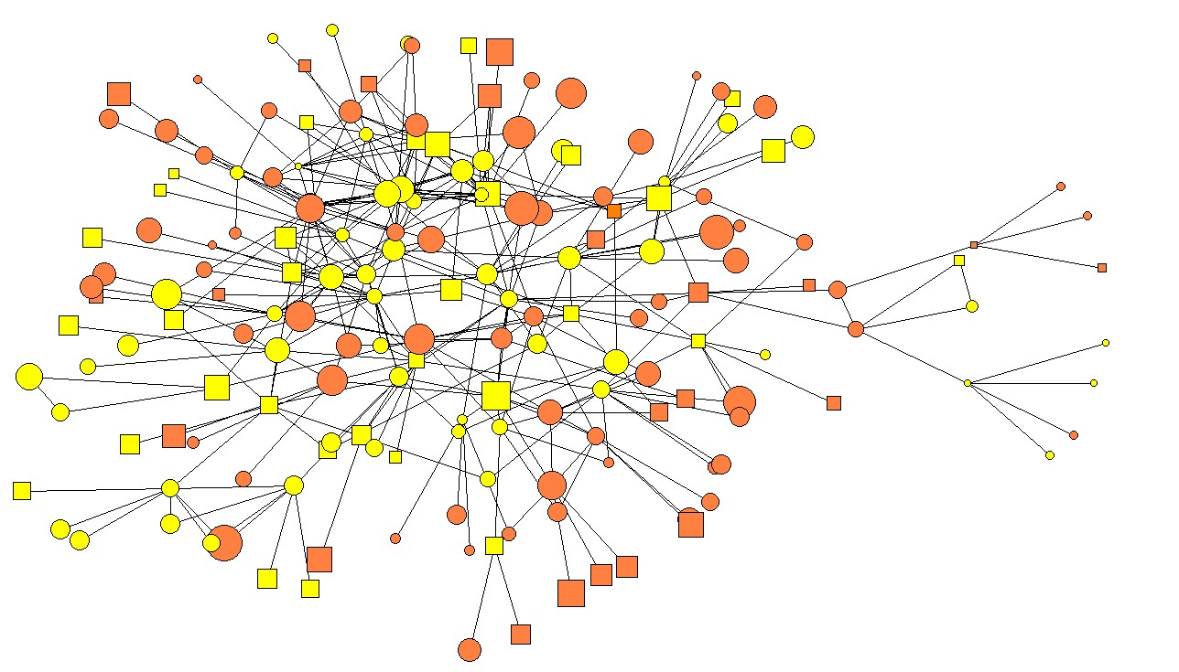
PWID with Facebook network ties on the IOW
N=179
>Size = increasing age; Yellow = connected via Facebook; Square = female

Slide 21
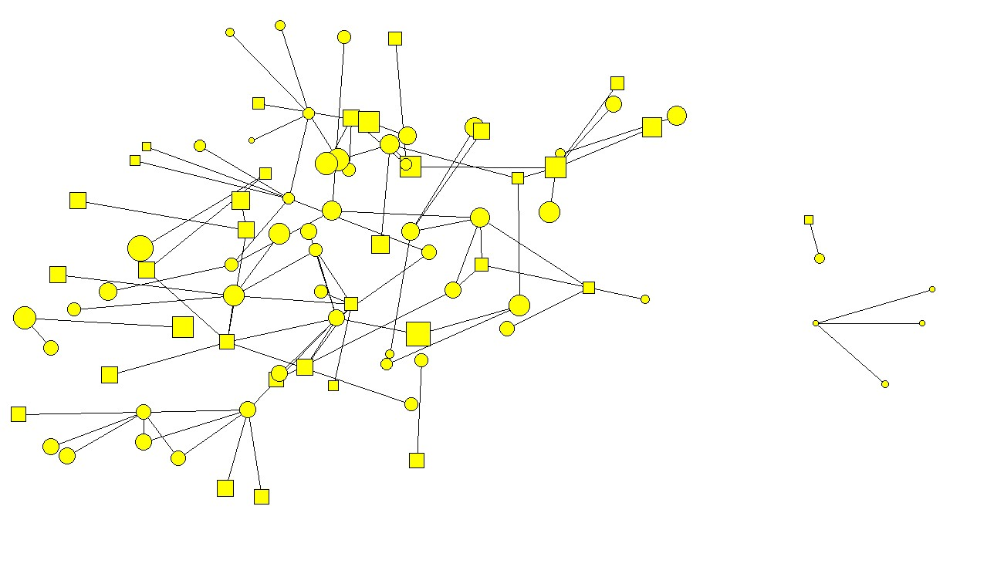
Facebook sub-network of PWID on the IOW
>Size = increasing age; Yellow = connected via Facebook; Square = female

Slide 22



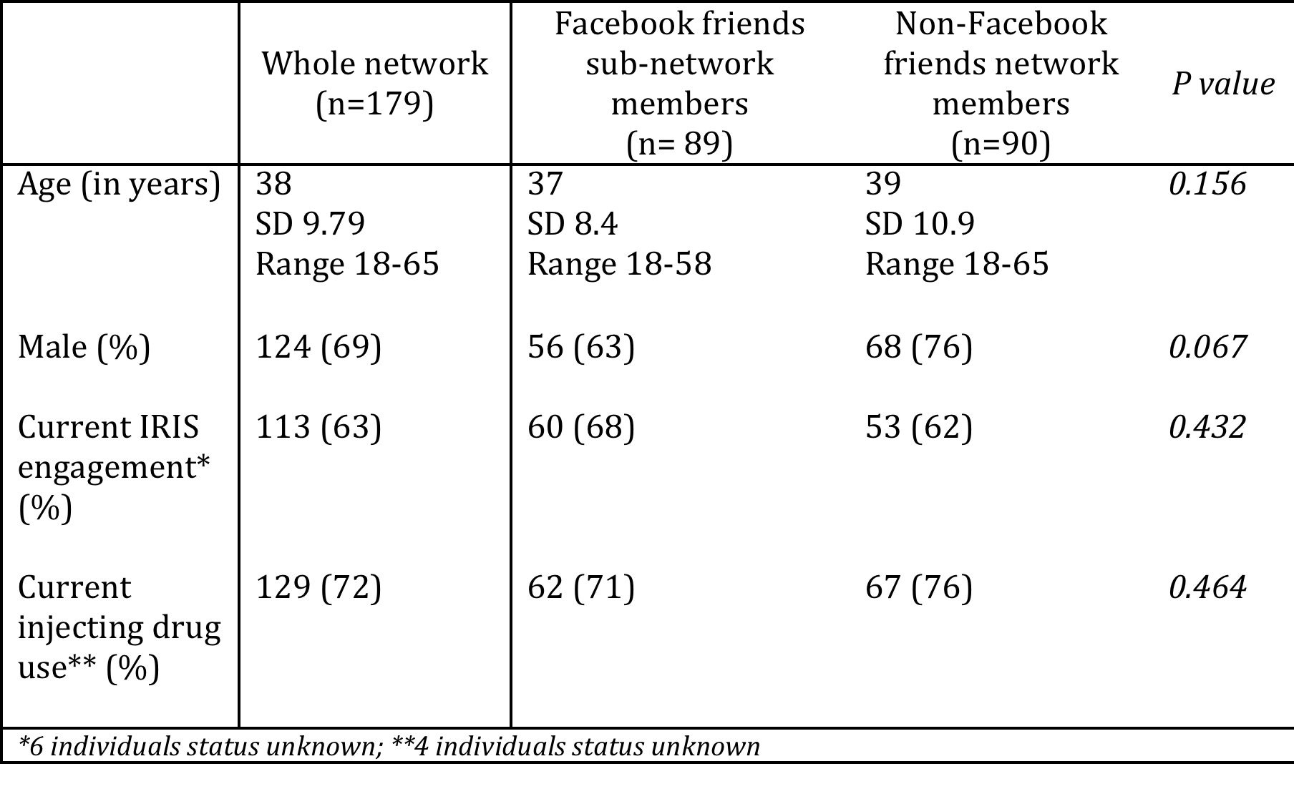
Comparing physical and Facebook network members

Slide 23
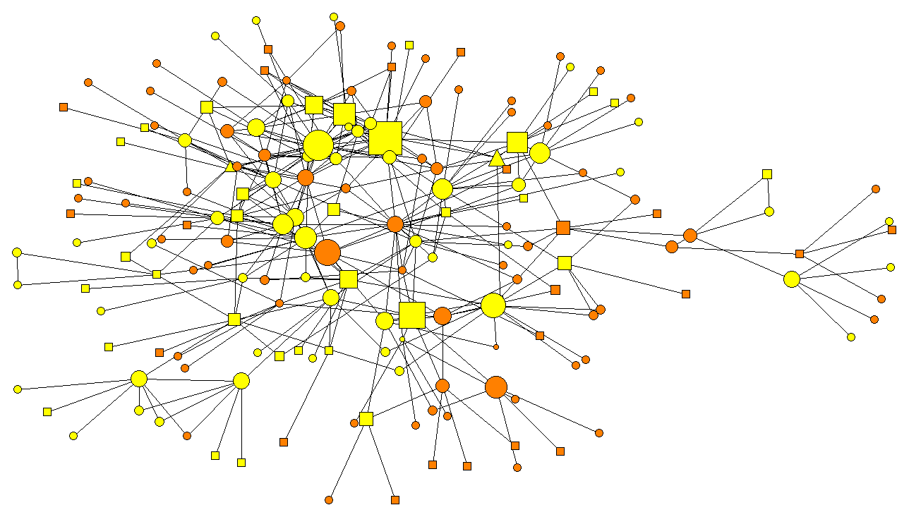
Network measure – In-degree centrality
>Size = increasing in-degree centrality; Yellow = connected via Facebook; Square = female

Slide 24


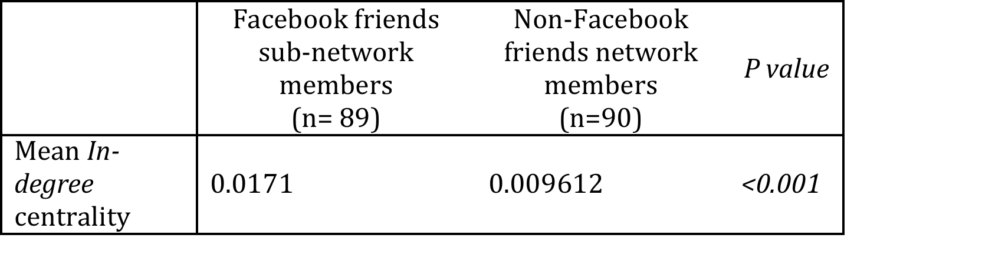
Network measure – In-degree centrality

Slide 25
Conclusions
Almost all PWID who have a Facebook profile were connected through FB friendship to another PWID within the physical network
Facebook connects approx. 50% of PWID in the physical network
Those towards the centre of the physical network are more likely to be connected to other PWID via Facebook
Facebook has the potential to promote HCV in the core of the PWID network on the IOW…but

Slide 26
Limitations
Study conducted in a single (unique?) population
Small target population – wide confidence intervals
Network measures affected by missing data
Reliance on recall and candidness of survey participants

Slide 27



Acknowledgments & Affiliations
NIHR CLAHRC Wessex in partnership with:
Ryan Youde (medical student, University of Southampton)
Research supervisors:
Salim I Khakoo
Julie Parkes
Leonie Grellier
Staff at:
Gibbs and Gurnell pharmacy, Ryde, IOW
Day Lewis Pharmacy, Shanklin, IOW
Regent pharmacy, East Cowes, IOW
IRIS drug support centre, Newport, IOW
St Mary’s Hospital R&D department, IOW

Slide 28
References
Stanaway JD, Flaxman AD, Naghavi M, Fitzmaurice C, Vos T, Abubakar I, et al. The global burden of viral hepatitis from 1990 to 2013: findings from the Global Burden of Disease Study 2013. Lancet. Elsevier; 2016 Jul;0(0):988–97
Public health England. Report on Hepatitis C. 2015. Available online:
Innes H, Goldberg D, Dillon J, Hutchinson SJ. Strategies for the treatment of Hepatitis C in an era of interferon-free therapies: what public health outcomes do we value most? Gut. BMJ Publishing Group Ltd and British Society of Gastroenterology; 2015 Nov;64(11):1800–9.
Friedman et al. Networks and HIV risk: an introduction to social network analysis for harm reductionists. International Journal of Drug Policy 9 (1998) 461–469
Booth RE, Lehman WEK, Latkin CA, et al. Individual and Network Interventions With Injection Drug Users in 5 Ukraine Cities. Am J Public Health. 2011;101(2):336-343

Slide 29
References
6. Laranjo L, Arguel A, Neves AL, Gallagher AM, Kaplan R, Mortimer N, et al. The influence of social networking sites on health behavior change: a systematic review and meta-analysis. J Am Med Inform Assoc [Internet]. 2014;1–10. Available from: http://www.ncbi.nlm.nih.gov/pubmed/25005606
7.Greene JC, Caracelli VJ, Graham WF. Toward a Conceptual Framework for Mixed-Method Evaluation Designs. Educ Eval Policy Anal. 1989;11(3):255-274.
8. Hollstein B. Mixed methods in social networks research an introduction. In: Dominguez Silvia, Hollstein B, eds. Mixed Methods Social Networks Research. 1st ed. New York: Cambridge University Press; 2014:3-32.
9. Heckathorn DD. SNOWBALL VERSUS RESPONDENT-DRIVEN SAMPLING. Sociol Methodol. 2011;41(1):355-366.

