Slide 1
Leeds Institute of Health Sciences
Academic Unit of Psychiatry and Behavioural Sciences
Student alcohol consumption:
Patterns & web-based interventions
Bewick, B.M., Harrison, W., Barkham, M., Mulhern, B, and Hill, A.J.
SSA November 2008
All images from this presentation have been removed due to copyright restrictions
Presented at the SSA Symposium 2008

Slide 2
Leeds Institute of Health Sciences
Academic Unit of Psychiatry and Behavioural Sciences
How much do students drink?

Slide 3

Leeds Institute of Health Sciences
Academic Unit of Psychiatry and Behavioural Sciences
n=7542
year 1 n=3068, year 2 n=2444, year 3 n=2030

Slide 4
Leeds Institute of Health Sciences
Academic Unit of Psychiatry and Behavioural Sciences
Bewick et al. (2008) BMC Public Health 8:163

Slide 5
Leeds Institute of Health Sciences
Academic Unit of Psychiatry and Behavioural Sciences
Bewick et al. (2008) BMC Public Health 8:163

Slide 6
Leeds Institute of Health Sciences
Academic Unit of Psychiatry and Behavioural Sciences
When are students drinking?

Slide 7


Leeds Institute of Health Sciences
Academic Unit of Psychiatry and Behavioural Sciences
For details of the latent class analysis please contact b.m.bewick@leeds.ac.uk

Slide 8
Leeds Institute of Health Sciences
Academic Unit of Psychiatry and Behavioural Sciences
Could a web-based approach work?

Slide 9
Leeds Institute of Health Sciences
Academic Unit of Psychiatry and Behavioural Sciences
e-UNICAL: Personalised feedback
Alcohol consumption
    Units consumed per week
    Number of alcohol free days
    Binge drinking behaviour
Social norms
    The percentage of students who drink less than them
    Perceived negative effects of alcohol perceived by other students who consume a similar amount of alcohol.
Information on support services

Slide 10
Leeds Institute of Health Sciences
Academic Unit of Psychiatry and Behavioural Sciences
What did students think?

Slide 11
Leeds Institute of Health Sciences
Academic Unit of Psychiatry and Behavioural Sciences

Slide 12
Leeds Institute of Health Sciences
Academic Unit of Psychiatry and Behavioural Sciences
Was there a change in consumption per week?

Slide 13
Leeds Institute of Health Sciences
Academic Unit of Psychiatry and Behavioural Sciences
Was there a change in consumption per occasion?

Slide 14
Leeds Institute of Health Sciences
Academic Unit of Psychiatry and Behavioural Sciences
*
Bewick et al. (2008) Addictive Behaviors 33:1192-1198

Slide 15
Leeds Institute of Health Sciences
Academic Unit of Psychiatry and Behavioural Sciences
e-UNICAL phase II: Preliminary results
*
*

Slide 16
Leeds Institute of Health Sciences
Academic Unit of Psychiatry and Behavioural Sciences
What about outside of University of Leeds?

Slide 17
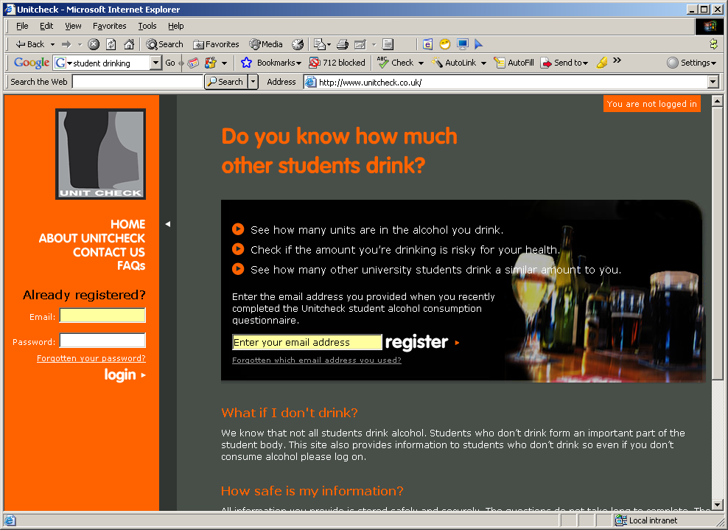

Leeds Institute of Health Sciences
Academic Unit of Psychiatry and Behavioural Sciences

Slide 18
Leeds Institute of Health Sciences
Academic Unit of Psychiatry and Behavioural Sciences
For details of the AERC trial results please contact b.m.bewick@leeds.ac.uk

Slide 19

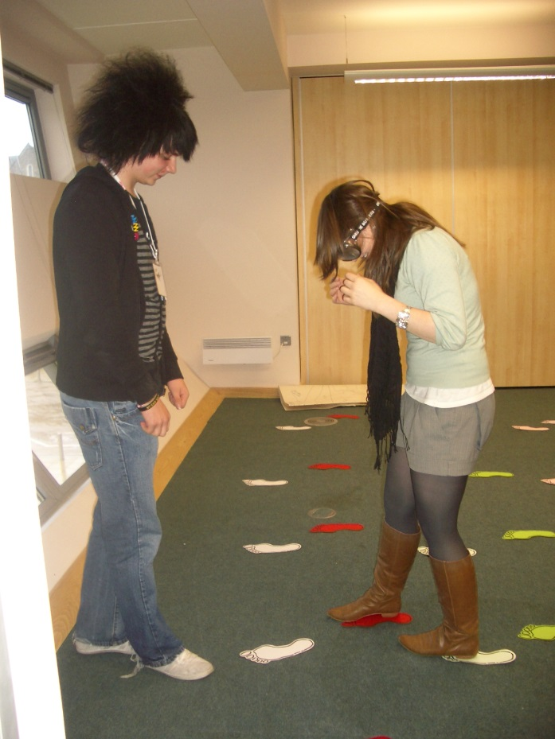
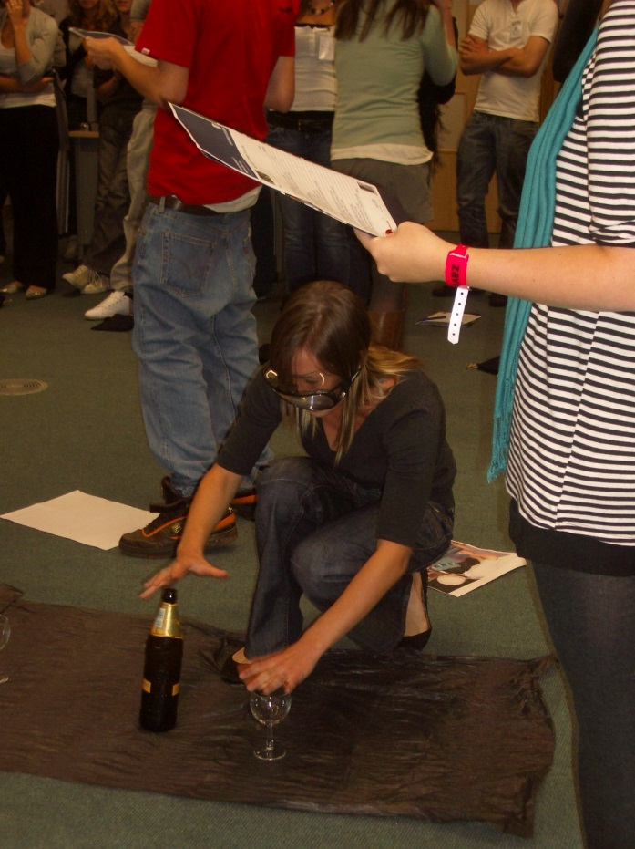
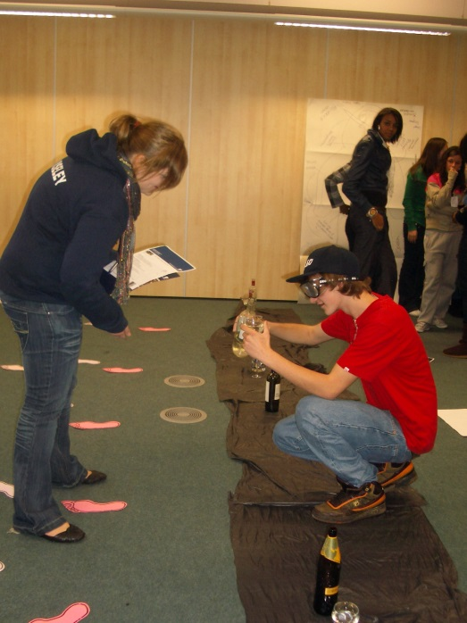



Leeds Institute of Health Sciences
Academic Unit of Psychiatry and Behavioural Sciences

Slide 20
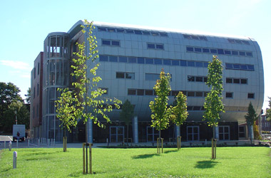
Leeds Institute of Health Sciences
Academic Unit of Psychiatry and Behavioural Sciences
Thanks for listening
Faculty of Medicine and Health, Charles Thackrah Building
101 Clarendon Road, Leeds, United Kingdom. LS2 9LJ
b.m.bewick@leeds.ac.uk
www.leeds.ac.uk/lihs
+44 (0) 113 343 0809

