Slide 1


Drinking to regret?
The relationship between alcohol use and traumatic memories
Benjamin Butterworth
Glasgow Caledonian University
benjamin.butterworth@gcu.ac.uk
@memoreasy

Slide 2
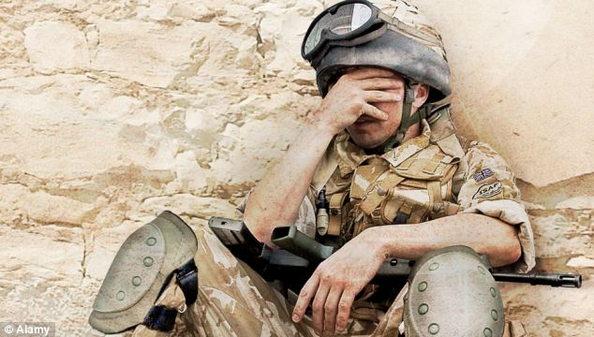

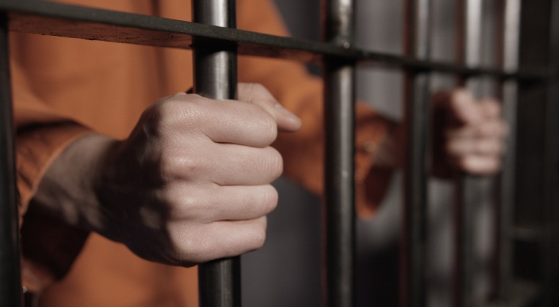
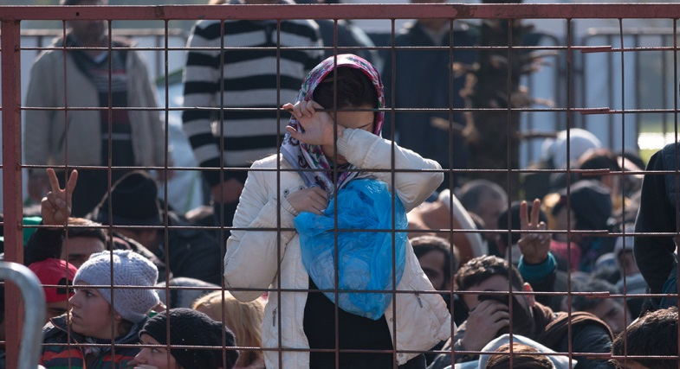
Alcohol and Psychological Trauma

Slide 3
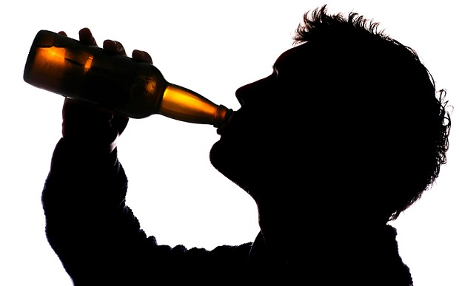
Evaluating the relationship
Alcohol
Distress
Memories

Slide 4
Questions
Benjamin Butterworth
Glasgow Caledonian University
benjamin.butterworth@gcu.ac.uk
@memoreasy

