Slide 1
An evaluation of the mutual aid facilitation sessions pilot ‘You do the MAFS’
Laura Aslan
MSc Forensic Psychology
Assistant Clinical Psychologist
Independent Researcher
s8lhw@hotmail.com

Slide 2
You do the MAFS
An group-based intervention designed to provide service users with knowledge of, and a pathway into mutual aid.
Delivered by those living a life in recovery themselves.

Slide 3
Dear Albert
Designed by Jon Roberts, founder of Dear Albert, social enterprise.
The name Albert was Jon’s street name, before he entered into drug and alcohol treatment.
‘In Rehab, one of the things they asked me to do was to write a letter saying goodbye to the addict within. Usually these letters start Dear Addict. When I went back to read what I’d written, I realised I’d written Dear Albert. At that moment I started to understand what was really going on; that my drug and alcohol use had become part of an elaborate falsehood. From that moment on I decided that I didn’t want to be Albert any more’.
Notes:
MAFS was developed by Jon Roberts, the founder of DearAlbert.

Slide 4
Notes:
Jon isnt here today but part of the MAFS programme incudes watching this locally produced documentary that captures certain aspect of the recovery process and id like to show you a small clip of this.
Film
From that clip you heard Jon mention…team work , effort, people coming together and that’s what mutual aid is all about….

Slide 6
Mutual Aid
Groups of people coming together to share their experiences in an attempt to gain support for their own recovery as well as supporting others (Humphreys, 2004).
Free and voluntary meetings
Experiential knowledge
Clients who partake in mutual aid are more likely to sustain their recovery (ACMD, 2013; Humphreys, 2004; PHE, 2013; NICE 2011,12,13; NTA, 2010)
Notes:
Advisory council on misuse of drugs..

Slide 7
Mutual aid
Despite these findings, attending mutual aid, knowledge and understanding of mutual aid remains a stumbling block for service users who may benefit from engagement.
Research suggests that ‘taster’ sessions, intensive referrals and active peer support can increase mutual aid attendance (Manning et al, 2012; Timko & DeBenedetti, 2007)
Where are the pathways??

Slide 8
‘You do the MAFS’
Mutual aid facilitation sessions.
Peer-led social enterprise, Dear Albert.
MAFS provides a choice of abstinence-based solutions and aims to encourage service users to make their own decisions about which aspects of MAFS they feel will contribute to their recovery.
A programme designed to develop service users understanding of mutual aid and provides a pathway/ gateway into attending mutual aid groups.
Notes:
Here is one pathway
Lead by people in recovery themselves

Slide 9
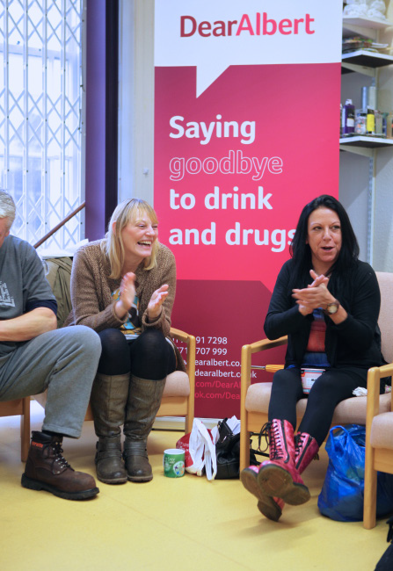
MAFS
2.5 hours a week for 6 weeks
Fundamental topics discussed
12 step
SMART
Same vibe as mutual aid group
Participants expected to attend at least one mutual aid group outside of MAFS
Support offered surrounding this
Notes:
The course consists of formal group sessions that run for 2.5 hours a week for 6 weeks.
Fundamental topics - hisotry of mutual aid, different types- 12 step and SMART, NA, AA, etc.
Group check ins are used where each individual will discuss their week.
In this respect the vibe of each session is similar to that of a 12 step or SMART mutual aid meeting this providing participants with an experiential element of mutual aid.
Participants expected to attend at least one mutual aid group outside of the MAFS sessions. For example service users are provided with a list of local groups that run, where and what time and support is offered to attend these; ‘lets all go tonight’, il come and pick you up. Lead by the facilitators.

Slide 10
Pilot study
Mixed methodology
Quantitiative data- used standardised measures to observe changes in physical and mental well being and psychological distress.
Logged levels of substance misuse and mutual aid attendance.
Pre, post and follow up
Notes:
Core 10
tops

Slide 11
Pilot study
Qualitative- end of programme focus group, and semi structured interviews
Analysed using applied thematic analysis.
Participants
No. of participants in study | n=19
Male: female | 13:6
Age range | 25-60
Substance | Alcohol primary substance/ then heroin. Many co-morbid substance use

Slide 12
Quantitative Findings
Participants reduced their psychological distress by 32% by the end of the MAFS programme.
By follow up (1 month post MAFS) this had reduced further to 49%.
Health and social functioning improved along with participation on the course and still improving at follow up.
84% of cohort attending Mutual aid groups by end of the MAFS course. At follow up, 8/10 were still attending MA.
72% reduced their Substance use by end of MAFS programme.
Notes:
Psych. Distress reduced by 32% (statistically sig t=13.4, p=0.000)
By follow up reduced further to 49% (statistically sig t=3.2, p=0.01)
H&S functioning- of the domains, (psychological health/physical health/ overall qual), ‘Overall quality of life’ showed most consistent and significant improvements throughout study.
MA- 16/19 tried a group. Prior to MAFS 10 of these participants had never tried a MA group before.
SU- out of the 11 SUs who started MAFS with active addictions, 8 reduced their use. Within these 8, 1 became abstinent and 2 had stopped using their primary substance.

Slide 13
What the service users said…
‘I don’t know if id have gone back to AA again if it hadnt have been for someone saying come on, im going to this meeting, meet me here at this time and we can go together… and that was it…because other people committed, I committed. It’s the best thing ive ever done’
‘This was the first group, first time I had asked for help..i wouldn’t have gone to mutual aid due to my anxieties, it helped a lot. I was anti before, I didn’t believe in mutual aid, I didn’t think about it, didn’t know it was available’
‘I attend SMART twice a week. It doesn’t tell me anything new but it gives me a reason to stop. I wouldn’t like to go and say ive relapsed…I would feel like im letting them down, its helps me stay sober’
‘I’ve made friends from MAFS and some of them go to the same SMART group on Saturday so its all good. Its nice to meet new people and share things’
Notes:
Participants said that MAFS provides them with a pathway into MA.
The MAFS group itself is a safe and secure place to explore routes to recovery.
Most SUs in the study were able to find some element of MA that helped them and those that weren’t reported benefits from attending the MAFs group regardless.
Contagion- facilitators in recovery themselves, appeared to make recovery more attractive and attainable and real…people getting well, someone comes into the room and they are more likely to get well too… power of the group.

Slide 14
Discussion
Mutual aid membership can increase social and cultural recovery capital yet awareness of this blurred.
You do the MAFS was set up to provide a pathway into mutual aid.
Pilot study showed that attending MAFS and attending MA went some way to increase overall wellbeing and reduce life distress.
Key points are that substance use reduced across the cohort and service users were still attending mutual aid groups a month after the MAFS course had finished.
Notes:
Social/cultural recovery capital- positive and supportive social network.
Culture of recovery, of making changes
Meaningful engagement

Slide 15
What worked well
Service users liked the autonomy of being given information on all types of MA and being able to chose what worked best for them.
Pre-requisite of completion was to try at least one mutual aid group.
The holistic support offered through peer facilitators.
Notes:
Service users signed up to this at the beginning and this worked well to get people to try MA through structured support. Indeed, as an incentive
A key aspect of the programme was contingency management, incentive/bribe- hamper making r visible…

Slide 17
Limitations & the future
Study provides some evidence towards the effectiveness of mutual aid.
Highlights the benefits of developing more structured and intensive pathways into mutual aid.
This study did not include RCT (randomised controlled trial) and was of modest sample size, therefore the positive outcomes may not be attributable to ‘You do the MAFS’ alone.
Researcher would have benefitted from speaking to the service users who dropped out of MAFS early on.

Slide 18
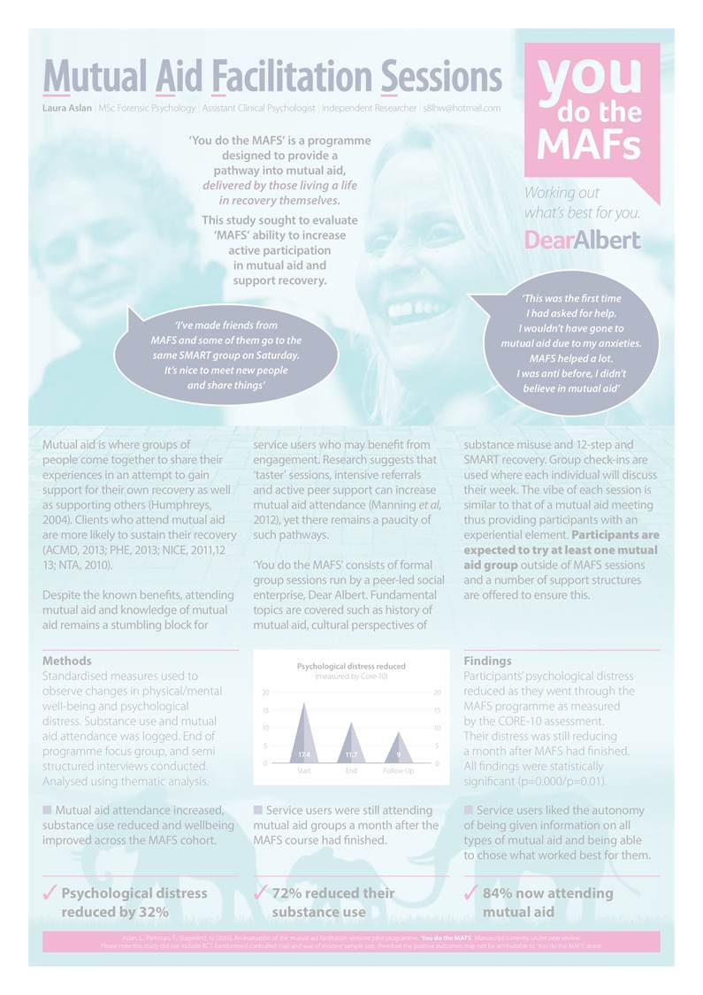
Any Questions www.dearalbert.co.uk

