Slide 1

Older Female Drug Users: Negotiating Identities through Drug Use, Treatment, Recovery and Beyond
April Shaw
University of Glasgow
a.shaw.2@research.gla.ac.uk

Slide 2

Research Question
To explore the influence of
social relationships and health
on identity and recovery
among older drug using females.

Slide 3
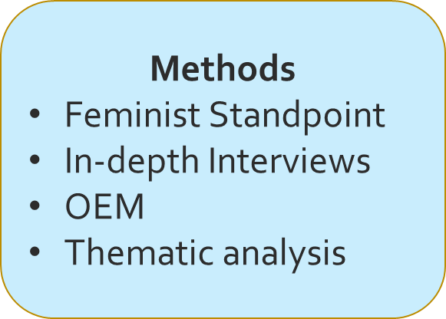
Methods
Sample
15-20 women
Ages 35+
Illicit substance use
Recovery (self-identified)

Slide 4
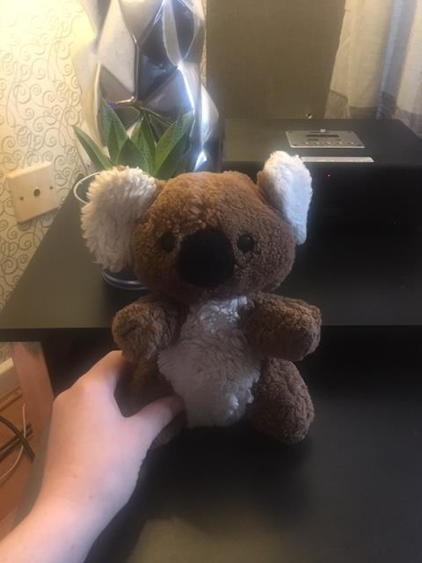
Object Elicitation
  what is this image of, what is its content?
  how do these photographed objects relate to the research question
Ruth “… every time I see this teddy it reminds me of that day lying in a police cell praying to god my son doesn’t get taken into care and also how far we’ve came and how good and different life is today.“

Slide 5
Progress & Next steps
9 interviews
8 urban
Age range: 36 – 55
Recovery: 18 mths – 21 years
Targeted sampling
> Over 50s
> Rural
> Early recovery

Slide 6
REFERENCES
Boeri, M. (2018). Hurt: Chronicles of the Drug War Generation. University of California Press.
Braun, V. and Clarke, V. (2006) Using thematic analysis in psychology. Qualitative Research in Psychology, 3 (2). pp. 77-101
Goffman, E. (1959). The presentation of self in everyday life Doubleday: Mayflower.
Skinner, J. (Ed.). (2013). The interview: An ethnographic approach (Vol. 49). A&C Black.
Romano, D., McCay, E., & Boydell, K. (2012). The use of material objects in understanding the process of recovery from a first episode of schizophrenia. Arts & Health, 4(1), 70-82.

