Slide 1
ALICE RAP and the addictions health footprint –
toward a redesign of addictions governance
Society for the Study of Addiction
2014 Society Lecture
Professor Peter Anderson, MD, MPH, PhD, FRCP
Institute of Health and Society, Newcastle University
Faculty of Health, Medicine and Life Sciences, Maastricht University
York, 6 November 2014

Slide 3
Awareness creation
Design
Economic incentive
Behaviour
ICT
Development
Trade
Infrastructure
Population size
Corporate influence
Services
Products
Non-health policies
GDP per capita
Health Footprint
Human biology
Governance
Urbanization
Population structure
Research and development
Technology
Industrialization
Direct regulation
Information provision

Slide 4
Health Footprint as a management and monitoring tool for accountability in reducing the harm done by addictive substances

Slide 5
Awareness creation
Design
Economic incentive
Behaviour
ICT
Development
Trade
Infrastructure
Population size
Corporate influence
Services
Products
Non-health policies
GDP per capita
Health Footprint
Human biology
Governance
Urbanization
Population structure
Research and development
Technology
Industrialization
Direct regulation
Information provision

Slide 6
Awareness creation
Design
Economic incentive
Behaviour
ICT
Development
Trade
Infrastructure
Population size
Corporate influence
Services
Products
Non-health policies
GDP per capita
Health Footprint
Human biology
Governance
Urbanization
Population structure
Research and development
Technology
Industrialization
Direct regulation
Information provision

Slide 7
Awareness creation
Design
Economic incentive
Behaviour
ICT
Development
Trade
Infrastructure
Population size
Corporate influence
Services
Products
Non-health policies
GDP per capita
Health Footprint
Human biology
Governance
Urbanization
Population structure
Research and development
Technology
Industrialization
Direct regulation
Information provision

Slide 8
Awareness creation
Design
Economic incentive
Behaviour
ICT
Development
Trade
Infrastructure
Population size
Corporate influence
Services
Products
Non-health policies
GDP per capita
Health Footprint
Human biology
Governance
Urbanization
Population structure
Research and development
Technology
Industrialization
Direct regulation
Information provision

Slide 9
Awareness creation
Design
Economic incentive
Behaviour
ICT
Development
Trade
Infrastructure
Population size
Corporate influence
Services
Products
Non-health policies
GDP per capita
Health Footprint
Human biology
Governance
Urbanization
Population structure
Research and development
Technology
Industrialization
Direct regulation
Information provision

Slide 10
Awareness creation
Design
Economic incentive
Behaviour
ICT
Development
Trade
Infrastructure
Population size
Corporate influence
Services
Products
Non-health policies
GDP per capita
Health Footprint
Human biology
Governance
Urbanization
Population structure
Research and development
Technology
Industrialization
Direct regulation
Information provision

Slide 11
Awareness creation
Design
Economic incentive
Behaviour
ICT
Development
Trade
Infrastructure
Population size
Corporate influence
Services
Products
Non-health policies
GDP per capita
Health Footprint
Human biology
Governance
Urbanization
Population structure
Research and development
Technology
Industrialization
Direct regulation
Information provision

Slide 12
Awareness creation
Design
Economic incentive
Behaviour
ICT
Development
Trade
Infrastructure
Population size
Corporate influence
Services
Products
Non-health policies
GDP per capita
Health Footprint
Human biology
Governance
Urbanization
Population structure
Research and development
Technology
Industrialization
Direct regulation
Information provision

Slide 13
Human evolution would suggest that we are
“active and functional”
in relation to the drugs that we take, including alcohol and nicotine, rather than being
“passive and vulnerable”

Slide 14
Co-evolution with nicotine, a plant toxin
Functional use of alcohol, as part of a fruit-eating diet

Slide 15
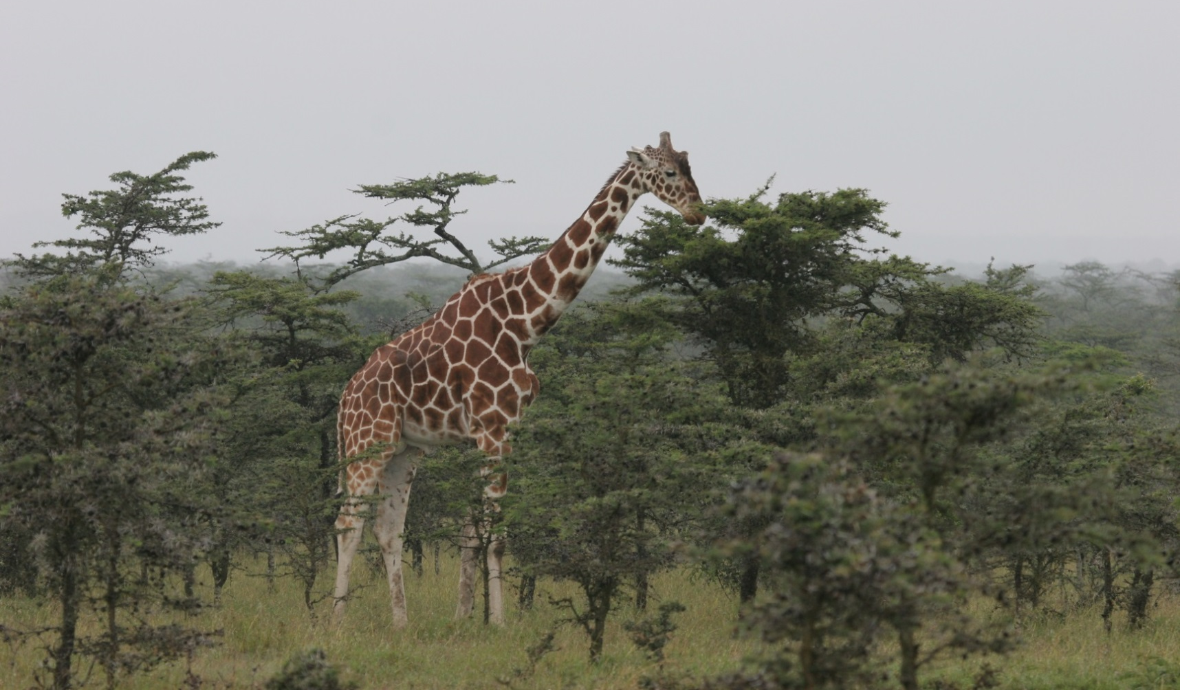
In the story of life over the last 400 million years, one of the main plot lines has been the battle between plants, and the animals that eat them.

Slide 16
Of many defense mechanisms, plants produce secondary metabolites, including nicotine, morphine, and cocaine, potent neurotoxins that evolved because they punished and deterred consumption by plant-eating animals
Source: Sullivan & Hagen 2014

Slide 17
To inhibit and kill their own parasites, animals have evolved to counter-exploit the products of hundreds of millions of years of "research' by plants by subsisting on a mixed diet of palatable and toxic plants, trading off diet quality (and thus growth) for what is termed enemy-reduced or enemy-free space.
Source: Sullivan & Hagen 2014

Slide 20
When parasitized, hornworm survives better by eating nicotine than by not eating nicotine
Source: Singer et al. 2009

Slide 21
When unparasitized, hornworm survives better when not eating nicotine than when eating nicotine
Source: Singer et al. 2009

Slide 22
There is evidence for human pharmacophagy;
also, human ancestors may have exploited plant toxins to overcome nutritional and energetic constraints on CNS signaling;
use of these toxins is widespread in the archaeological record
Source: Sullivan & Hagen 2014

Slide 24
On average, each individual ripe fruit (weight 30g) contains 100 mg ethanol and each individual over-ripe fruit contains 400mg ethanol
Source: Dudley 2004

Slide 25
The presence of ethanol within ripe fruit suggests low-level but chronic dietary exposure for all fruit-eating animals.
Volatilized alcohols from fruit could potentially serve in olfactory localization of nutritional resources
Source: Dudley 2014

Slide 26
Primate ancestors living 16-21 million years ago could not effectively metabolize consumed ethanol.
However, by 6-12 million years ago, human’s last common ancestor with gorillas and chimpanzees had evolved a digestion fully capable of metabolizing consumed ethanol, at levels found in fermenting fruits.
Source: Benner 2013

Slide 27
Thus, human evolution would suggest that we are
“active and functional”
in relation to the drugs that we take, including alcohol and nicotine
This has three implications:

Slide 28
First:
Prohibition and "war(s) on drugs” are doomed to failure, because substance use is not "caused" by biological frailty in people overall.

Slide 29
Second:
Understanding the ecological contexts and dynamics of drug use may point to new preventive and clinical approaches – anti-worm treatment, for example, reduces cigarette use.

Slide 30
Nicotine treatment for helminth worms in humans
Cotinine concentration by worm burden (log scale) in Congo basin male hunter gatherers
Source: Roulette et al. 2014

Slide 31
Impact of albendazole on cotinine concentration by baseline worm burden in Congo basin male hunter gatherers
Source: Roulette et al. 2014

Slide 32
Third:
“Active and Functional” speak to potency, quantity and availability (economic and physical) as being primary drivers of drug use and related harm.

Slide 33
In fact:
We have argued that you do not need more than quantity to define substance use disorders.
Source: Rehm et al 2013

Slide 34
Proportion (%) nicotine dependent persons by number of cigarettes smoked per day
Source: Rehm et al 2013

Slide 35
Number of DSM-IV criteria for alcohol dependence by grams alcohol per day (NESARC data)
Source: Rehm et al 2013

Slide 36
Thus:
Substance use disorders can be defined via ‘heavy use over time’, a dimensional, rather than a dichotomous concept that can also help reduce stigma.
Source: Rehm et al 2013

Slide 37
Awareness creation
Design
Economic incentive
Behaviour
ICT
Development
Trade
Infrastructure
Population size
Corporate influence
Services
Products
Non-health policies
GDP per capita
Health Footprint
Human biology
Governance
Urbanization
Population structure
Research and development
Technology
Industrialization
Direct regulation
Information provision

Slide 38
Margin of Exposure analysis compares the ratio of a toxic dose with the dose consumed. The toxic dose can be defined as the dose in animals that increases death rates by 10%.
MoE=1: consuming toxic dose
MoE=100: consuming 1/100th toxic dose

Slide 39
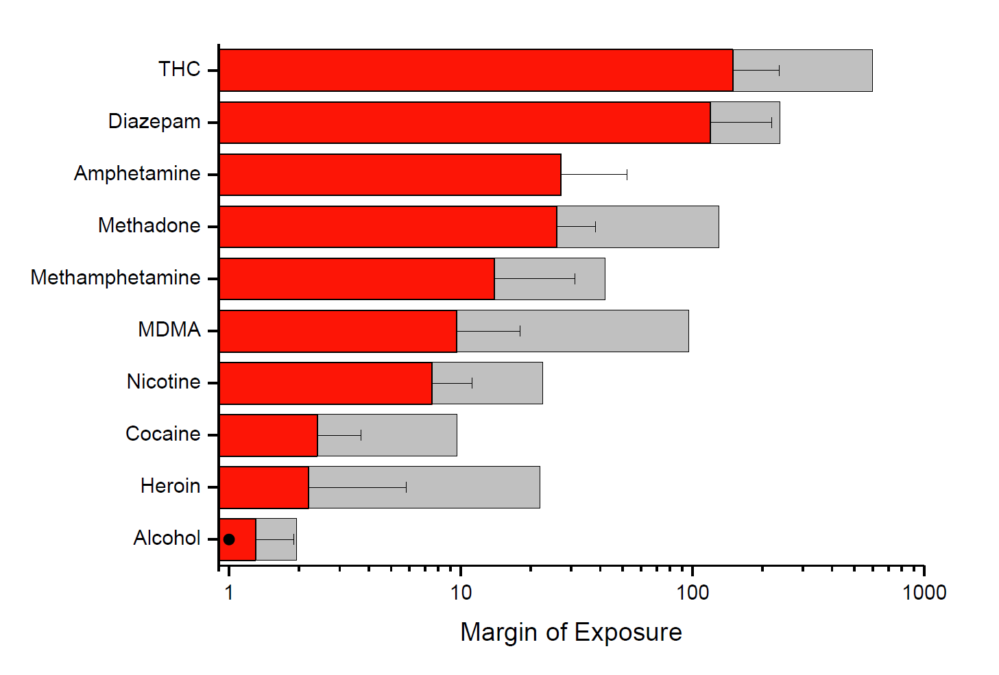
MoE SD Tolerant user
MoE=1.3; EU adults, on average, consume 77% of toxic dose
MoE=1.0; Based on 1.5% increased risk liver cirrhosis death
Source: Lachenmeier & Rehm 2014

Slide 40
MoE SD Tolerant user
European Food safety Authority: MoE for cancers based on human studies and voluntary exposure
EFSA MoE for non-cancers
Source: Lachenmeier & Rehm 2014

Slide 41
Risk of dying prematurely (up to age 70) due to alcohol consumption in European Union
Source: Rehm et al. 2014

Slide 42
Beer drinkers cannot readily distinguish low and regular strength beers and can enjoy socializing equally with either
(Segal & Stockwell 2008)
Discrimination of alcoholic strength by taste was possible to a limited degree in a window of intermediate alcoholic strengths, but not at higher concentrations (Lachenmeier et al 2014)

Slide 43
Prevalence of nicotine/cigarette use in UK
Source: West et al. 2014

Slide 45
“For every million smokers who switched to an e-cigarette we could expect a reduction of more than 6000 premature deaths in the UK each year”
Source: West & Browne 2014

Slide 46
Two historical areas framing the debate:
Attempts since 1950s for safer products
Changing status of nicotine since 1970s
Source: Berridge 2014

Slide 47
Failed attempts for safer products led to a previous desire for cooperation with industry to be replaced by an undisputed hostility towards industry

Slide 48
This hostility explained the lack of interest
in another development :
Re-categorising nicotine, by separating it from tobacco as a harm reduction product, remained at odds with a dominant public health ethos of abstention and opposition to all industry connections, including BIG Pharma

Slide 49
Studying corporate social responsibility:
“we found it almost impossible to speak to people in the tobacco industry; despite repeated efforts, we obtained only one industry interview”
Source: Baumberg et al 2014

Slide 50
Thus, a consideration of the (legal) products that we consume would conclude that:
“the potency of the drugs we consume (e.g., alcohol) are far too high, and the way that we deliver them (e.g., smoked cigarettes) are far too dangerous”
This has two implications:

Slide 51
First:
We have to get over our ambivalence of dealing with alcohol.

Slide 52
This represents less than 0.5% of the total amount of alcohol consumed - you cannot even measure if the pledge is achieved, let alone any impact on public health.

Slide 53
Second:
We have to get over our ambivalence of dealing with nicotine.

Slide 54
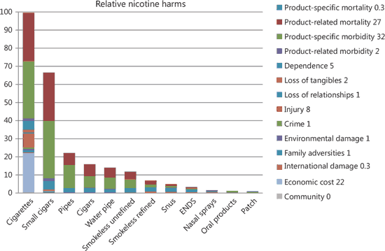
Source: Nutt et al 2014

Slide 55
Awareness creation
Design
Economic incentive
Behaviour
ICT
Development
Trade
Infrastructure
Population size
Corporate influence
Services
Products
Non-health policies
GDP per capita
Health Footprint
Human biology
Governance
Urbanization
Population structure
Research and development
Technology
Industrialization
Direct regulation
Information provision

Slide 56
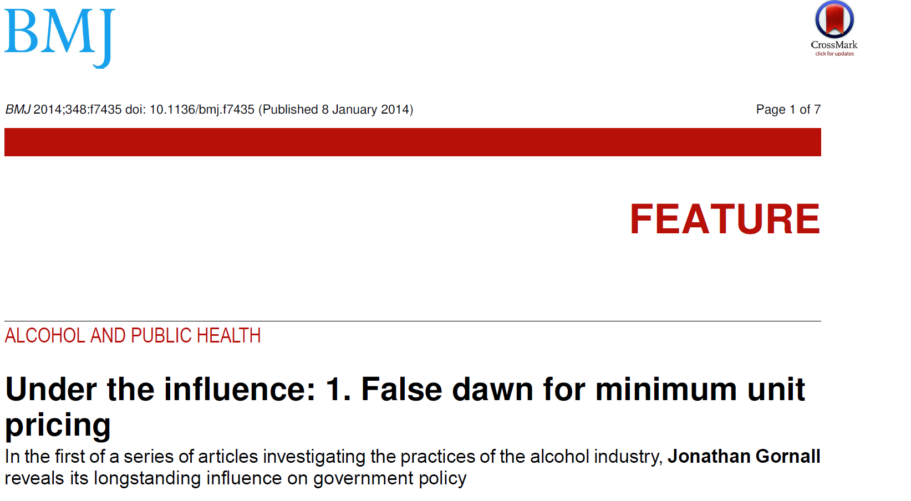
Source: Gornall 2014

Slide 57
“Just how that U turn was achieved is not only a story of the power of lobbying, dubious connections, and the expert dissemination of misinformation. It is also a story of a political system both dependent upon and happy to fraternise with the drinks industry, both outside parliament and within.
How else, for example, could it be seen as acceptable for a serving chancellor of the exchequer to accept the title Beer Drinker of the Year in celebration of his having cut duty on beer, and to pose for a photograph holding a beer named “Pennies from 11,” brewed in his honour?”
Source: Gornall 2014

Slide 58
The chancellor told the guests, “You can hopefully take what has happened this year as a recognition from all of us that we heard what you were saying and we listened and reacted.”
Source: Gornall 2014

Slide 59
Influence of Supermarkets
The story of a private meeting between the secretary of state for health and the chief executive of Asda supermarket—held three months after the government’s public consultation on minimum unit pricing for alcohol had closed—reveals not only the ease with which big players can access highest levels of government but also the incestuous web of influence spun by the think tanks and lobbying companies they employ.
Source: Gornall 2014

Slide 60
In April 2013 Asda contacted a special adviser in the Department of Health to seek a meeting with Jeremy Hunt, the health secretary. Among other issues, the company wished to discuss the “the status of the Minimum Unit Pricing (MUP) proposal.”
So far as the outside world was concerned, the government had already committed to the principle of minimum pricing. Its consultation, which had closed, had been concerned only with the level at which the price should be set.
Source: Gornall 2014

Slide 61
On 2 May, Asda had a “pre-meeting” at the Department of Health with Sam Talbot Rice, a former director of research at the Centre for Policy Studies, a right wing think tank. Talbot Rice had been appointed as one of the secretary of state’s special advisers.
Asda’s delegation included Martin Le Jeune, a former civil servant in the Cabinet Office and fellow of the Centre for Policy Studies, where Talbot Rice had previously worked.
[Stephen Parkinson, another former head of research at the Centre, was appointed a special adviser by Teresa May at the Home Office].
Source: Gornall 2014

Slide 62
Hunt’s briefing notes for the meeting included a passage which seems to indicate that the government’s consultation about the level to set the minimum price was not what it was: “Asda are opposed to MUP,” wrote the briefing. Hunt’s line should be “Government still considering the issue. Could be open to alternative proposals from industry. Welcome Asda’s views on this.”
Talbot Rice left the Department of Health in May 2013 to return to the Centre for Policy Studies, an organisation that has attacked the policy of minimum unit pricing as “illogical, authoritarian nonsense . . . illiberal [and] unfair.”
Source: Gornall 2014

Slide 63
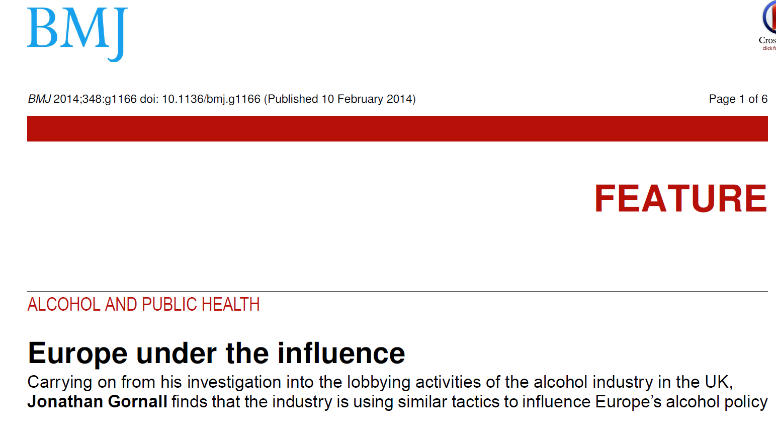
Source: Gornall 2014

Slide 64
“… nearly 138 000 people died prematurely (in the EU) of alcohol attributable causes in 2004 alone…Despite these shocking statistics, the European Commission has offered no resistance to the alcohol industry. Worse, under the auspices of its 2007 alcohol strategy it has instead collaborated with industry’s preference for self regulation, building it a voluntary platform from which it can shout loudly about corporate responsibility and voluntary commitments, concepts that have proved largely ineffective in preventing the health harms caused by its products.”
Source: Gornall 2014

Slide 65
The Food Information Regulation Directive, which has imposed mandatory health labelling requirements on food products, originally included alcohol in its scope, although it was taken out during the process. The rapporteur for the directive was Renate Sommer, vice-president of the European parliamentary beer club.
“My membership of the beer club had by no means influenced me in my role as rapporteur.”
Source: Gornall 2014

Slide 66
“As long as beer is being consumed responsibly it is a healthy product that contains vitamins, minerals, enzymes, and even anti-inflammatory ingredients.”
Asked if she considered economic growth and jobs to be more important than lives, she dismissed the question as “more than impertinent and even more tendentious than the others.”
Source: Gornall 2014

Slide 67
Thus, analysis of webs of influence would conclude that:
The potency of business influence on the policy process is far too high – “partnership between business and governments should always arouse intense suspicion” [Economist, 2005]
This has one implication:

Slide 68
Video Clip

Slide 69
Implication:
We need a redesign of government and economic systems.

Slide 70
Deal with:
Vetocracy

Slide 71
Mathematical modelling from geophysics studying decay of natural resource reservoirs demonstrates:
Dominant economic and political culture favour short-term and fast-scale economic and political gain at expense of environment (health)
Environmental (health) management can slow this process down, but management is constrained within the dominant economic and political culture
What really slows the process down to long-time-scale sustainable environment (health) is resistance taken from outside the dominant culture
Source: Werner 2012

Slide 72
Awareness creation
Design
Economic incentive
Behaviour
ICT
Development
Trade
Infrastructure
Population size
Corporate influence
Services
Products
Non-health policies
GDP per capita
Health Footprint
Human biology
Governance
Urbanization
Population structure
Research and development
Technology
Industrialization
Direct regulation
Information provision

Slide 73
Awareness creation
Design
Economic incentive
Behaviour
ICT
Development
Trade
Infrastructure
Population size
Corporate influence
Services
Products
Non-health policies
GDP per capita
Health Footprint
Human biology
Governance
Urbanization
Population structure
Research and development
Technology
Industrialization
Direct regulation
Information provision

Slide 74
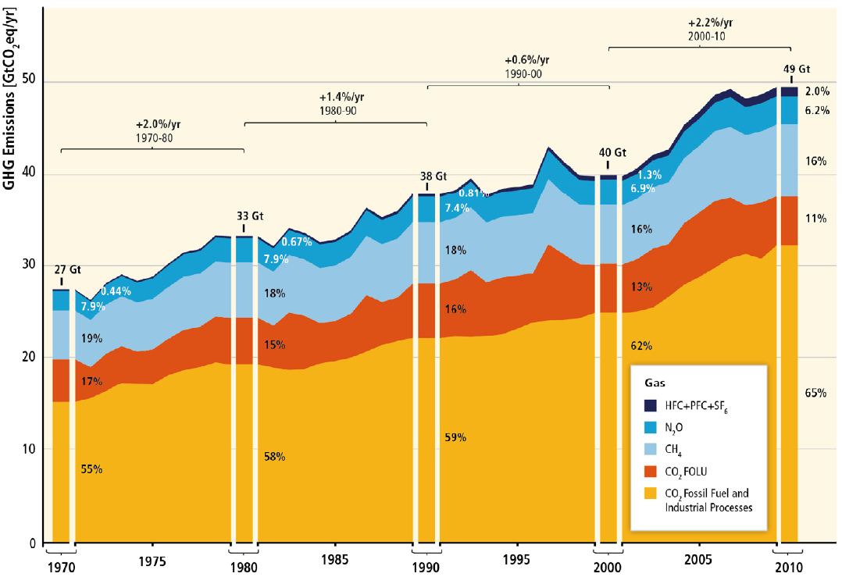
The central reason for estimating a carbon footprint is to help reduce the risk of climate change through enabling targeted reductions of greenhouse gas emissions.

Slide 75
In the same way, the health footprint (HFP) can be the accounting system for identifying the determinants of health and the management tool to evaluate opportunities by the public and private sectors and civil society to reduce health burden.

Slide 76
The carbon footprint can be defined as a measure of the total amount of greenhouse gas (primarily CO₂ and CH₄) emissions .

Slide 77
Similarly, the HFP can be defined as a measure of the total amount of health burden of a risk factor, sector or action within a spatial and temporal boundary of a defined population.
The HFP measures the impact of a range of immediate and underlying drivers of impaired health and the policies and measures that impact upon them.

Slide 78
Health footprints can be estimated for:
Nations, regions and cities
Policies
Sectors and organizations
Products and services
Individuals

Slide 79
Health footprints can be estimated for:
Nations, regions and cities
Policies
Sectors and organizations
Products and services
Individuals

Slide 80
The UK government’s U-turn on minimum unit price increased its health footprint by 9,000 preventable deaths over 10 years.
Who is accountable for that?

Slide 81
Health footprints can be estimated for:
Nations, regions and cities
Policies
Sectors and organizations
Products and services
Individuals

Slide 82
ABInBev, world’s largest brewer, contributed 3.34 million alcohol-attributable DALYs in 2012, 3.4% of all alcohol-attributable DALYs, and 0.13% of all DALYs.
ABInBEV could choose to commit to reducing its HFP by 10% to 3 million alcohol-attributable DALYs over the next five years.
ABInBEV products could be labelled with their global HFP contribution.

Slide 83
Thus, a Health Footprint accounts for who and what causes the harm done by addictive substances

Slide 84
Conclusion (1):
An ecological understanding of human drug use facilitates a range of solutions to reducing harm that goes beyond “wars”, labelling, and stigmatization of individuals

Slide 85
Conclusion (2):
A toxicological understanding of the drugs that humans use facilitates a range of solutions to reducing potency and to safer delivery systems that reduce harm

Slide 86
Conclusion (3):
A political understanding of drug producers’ influence facilitates a range of solutions to re-designing the present short-term fast-scale economic and political systems in favour of sustainable health (and environments)

Slide 87
Conclusion (4):
A health footprint can help drive change through identifying accountability and apportioning responsibility for lost years of healthy life.

Slide 88
Thank you for your attention
peteranderson.mail@gmail.com
www.alicerap.eu

