Slide 1
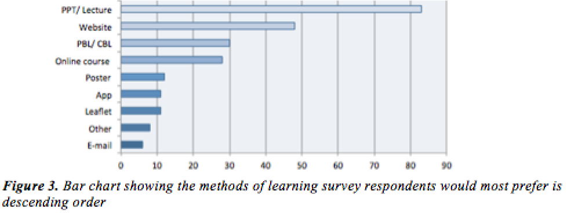
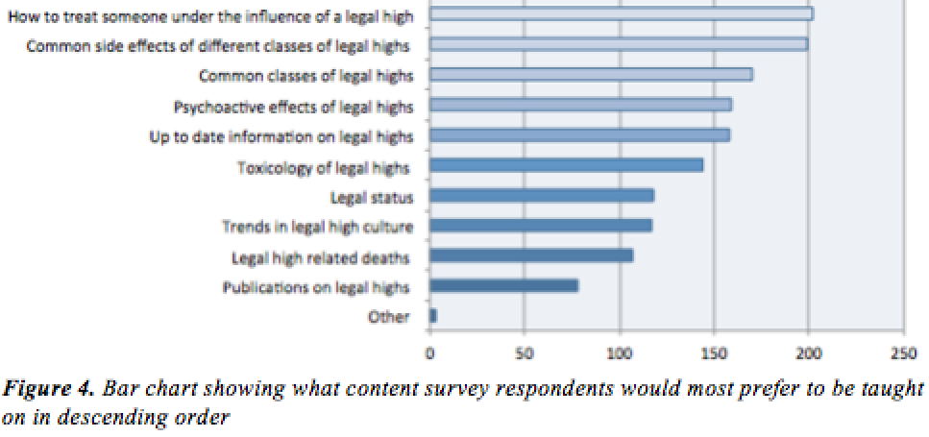

The Need for Education on Novel Psychoactive Substances (“Legal Highs”) amongst Undergraduate Health Care Professionals
Introduction
Novel Psychoactive Substances (NPS), commonly known as “legal highs”, have emerged into our drug markets in the past decade¹. They are increasingly being recognized as a problem because of the health harms they pose. Healthcare professionals (HCPs) now, and in the future, deal with the consequences of individuals taking these drugs, as patients². Therefore it is essential that they have sufficient knowledge on NPS, knowledge that they should obtain from their undergraduate degree courses
Results
284 undergraduate HCP students responded (23rd January – 13th February 2015)
49% Medicine; 51% Other HCP (Nursing; Diagnostic radiography; Postgraduate courses i.e. PhD; Social work courses; Physiotherapy; Masters; Paramedic science; Healthcare science; Midwifery)
Existing Knowledge
95.7% of respondents were aware of illegal drugs and knew what they were compared to only 53.8% that were aware of “legal highs” and knew what they were. 49.8% knew little about “legal highs”, with 44.4% knowing a moderate amount on illegal drugs. The majority (39.4%) of respondents agreed that users of “legal highs “will not get into trouble for using them.
2. Opinions on the Wider Contexts
Students were asked via a Likert scale if they thought that “legal highs “were a problem for: healthcare professionals; society; whether they are a political issue; whether they are a public health issue. Of these students agreed they were most a problem for public health.
3. Education
66.2% had no prior teaching on “legal highs”
59.5% would look to the Internet for information; 23.3% would look to the scientific literature
There is a need for education on “legal highs”– 31.1% strongly agreed; 54.1% agreed
Discussion
Given the demographic of young, technically proficient students, it was interesting that they still preferred a more formalized mode of learning via a PowerPoint Lecture.
Concurrently a survey was being undertaken by the EU-MADNESS Project³ asking academics what they were teaching on NPS. Comparing the data with the student survey there were similarities for example that very little was being taught about “legal highs”, and that teaching resources were limited.
Limitations
As the sample size was relatively small, it made it difficult to analyze by course or year of study.
As a self-administered survey I elicited convenience sampling. The respondents were not chosen at random. External validity was not promoted, therefore the sample may not be representative of the population.
Response bias may have led to inaccurate responses by respondents taking the survey.
Surveys are prone to non-response bias. There is a difference between the respondents and those that didn’t respond i.e. the 5% of the student population that responded against the other 95%.
Conclusions
The results showed that there is clearly a need and interest from undergraduate HCPs for educational inputs and resources on NPS. Students and academic lecturers agreed that a PowerPoint/ Lecture was the preferred method of teaching hence this was created as an educational resource (slides shown on the left).
Aims
To collect data on students’ attitudes; awareness and knowledge on NPS
To collect data on students’ perceptions of current level of teaching about NPS
To gain student views on teaching resources needed.
Hypothesis
There is a need for education on novel psychoactive substances/ “legal highs” amongst undergraduate healthcare professionals.
Methods
A literature survey was undertaken to gather background information and data
Designed a self-administered online survey to collect primary data from the undergraduate medical and HCP students at St George’s, University of London. Survey Monkey was used as a platform and a URL link to the survey was distributed via the University mailing list.
The survey sections were split into two sections. The first covered knowledge about “legal highs”, illegal drugs and legal status, risks and health harms. The second focused on educational needs, what teaching could be delivered and how.
Safia Akhtar
+44 7867507019
m1001132@sgul.ac.uk
St George’s, University of London
Research Project for Intercalated BSc in Basic Medical Sciences
Acknowledgments
Thank you to Christine Goodair and Dr. Colin Davidson for their expertise and guidance
References
1. UNODC, 2014 Global Synthetic Drugs Assessment. Vienna: UNODC, https://www.unodc.org/documents/scientific/2014_Global_Synthetic_Drugs_Assessment_web.pdf (accessed March 11, 2015)
2. Simonato P, et al.(2013) Novel psychoactive substances as a novel challenge for healthcare professionals: results from an Italian survey. Hum. Psychopharmacol. Clin.Exp.: 28 324-331 doi:10.1002/hup.2300
3. EU-MADNESS. About EU-MADNESS. 2014. http://www.eumadness.eu/about-eu-madness/ (accessed March 11, 2015)

