Slide 1
Accuracy of Alcohol Use Disorders Identification Test (AUDIT) for detecting problem drinking in 18-35 year old females and males in England: method comparison study
David R Foxcroft, Lesley A Smith,
Hayley Thomas, Sarah Howcutt
(Funded by ARUK)

Slide 2
Form and Function in a prevention matrix

Slide 3
Background
Cochrane review (in press): AUDIT had good accuracy for identifying hazardous drinking, alcohol abuse or dependence, but only one British study (N=194) with middle-aged men from a Welsh primary care setting; there were no studies that predominantly included young adults aged 18-35 or women from a UK primary care population.
UK NHS National Screening Committee (2011): some UK evidence for AUDIT as a valid test for alcohol misuse in men aged 35 to 54 but it is not clear which threshold scores should be used for women, younger adults, adults over 65 years, and ethnic minorities.

Slide 4
Research Question and Design
What is the accuracy of AUDIT for problem drinking in males and females aged 18-35 in England?

Slide 5
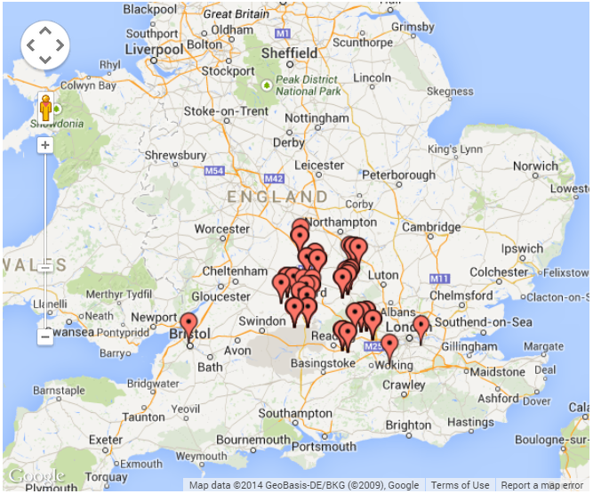
Research Question and Design
Method comparison study:
420 patients from 14 General Practices in the Thames Valley
Google Map Plot of Sample Location, based on postcode sectors

Slide 6
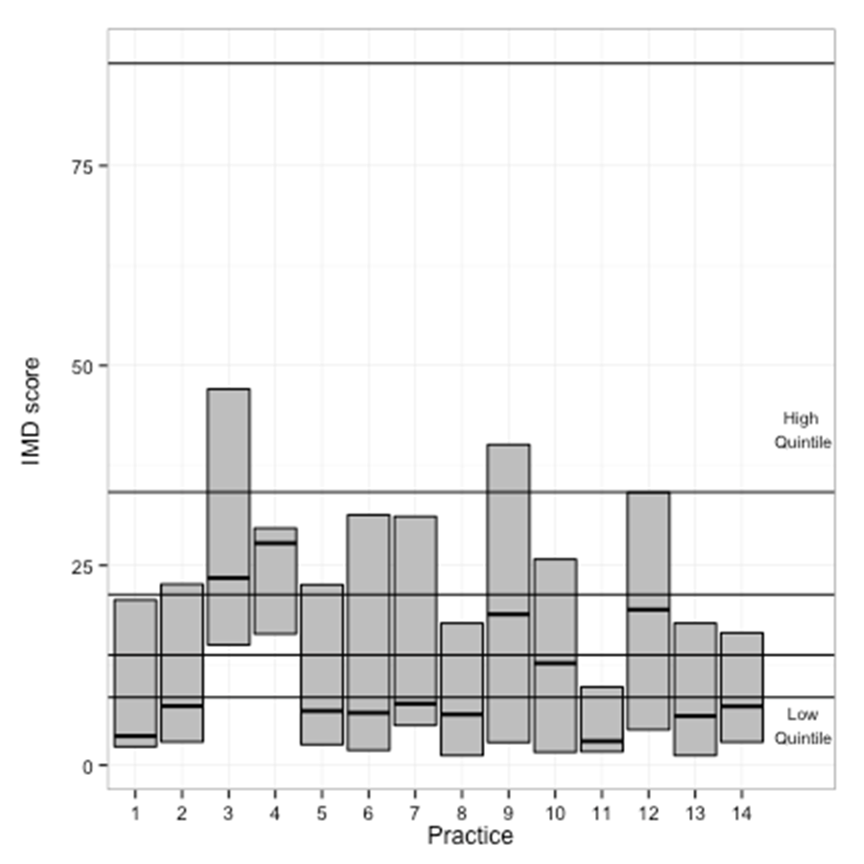
Research Question and Design
Method comparison study:
420 patients from 14 General Practices in the Thames Valley
Boxplots of median, min and max IMD score by Study Practice; with LLSOA Quintles for England

Slide 7
Research Question and Design
What is the accuracy of AUDIT for problem drinking in males and females aged 18-35 in England?
Method comparison study: 420 patients from 14 General Practices in the Thames Valley
AUDIT was the screening test measure. Reference standard measures were (i) the Time-Line Follow-Back (TLFB) structured interview for hazardous drinking; and the World Mental Health Composite International Diagnostic Interview (WMH-CIDI) for (ii) DSM-IV alcohol abuse, (iii) DSM-IV alcohol dependence, and (iv) the new DSM-5 alcohol use disorders classification.

Slide 8
Sensitivity and Specificity
Sensitivity measures the proportion of actual positives correctly identified as such (e.g. the percentage of problem drinkers who are correctly identified)
Specificity measures the proportion of negatives correctly identified as such (e.g. the percentage of non-problem drinkers who are correctly identified)
For any test, there is usually a trade-off between Sensitivity and Specificity, and this trade-off can be represented by a receiver operating characteristic (ROC) curve
Notes:
A perfect predictor would be described as 100% sensitive (i.e. all problem drinkers are identified as problem drinkers) and 100% specific (i.e. all non-problem drinkers are identified as non-problem drinkers).
For any test, there is usually a trade-off between the measures. For example: in an airport security setting in which one is testing for potential threats to safety, scanners may be set to trigger on low-risk items like belt buckles and keys (low specificity), in order to reduce the risk of missing objects that do pose a threat to the aircraft and those aboard (high sensitivity).

Slide 9
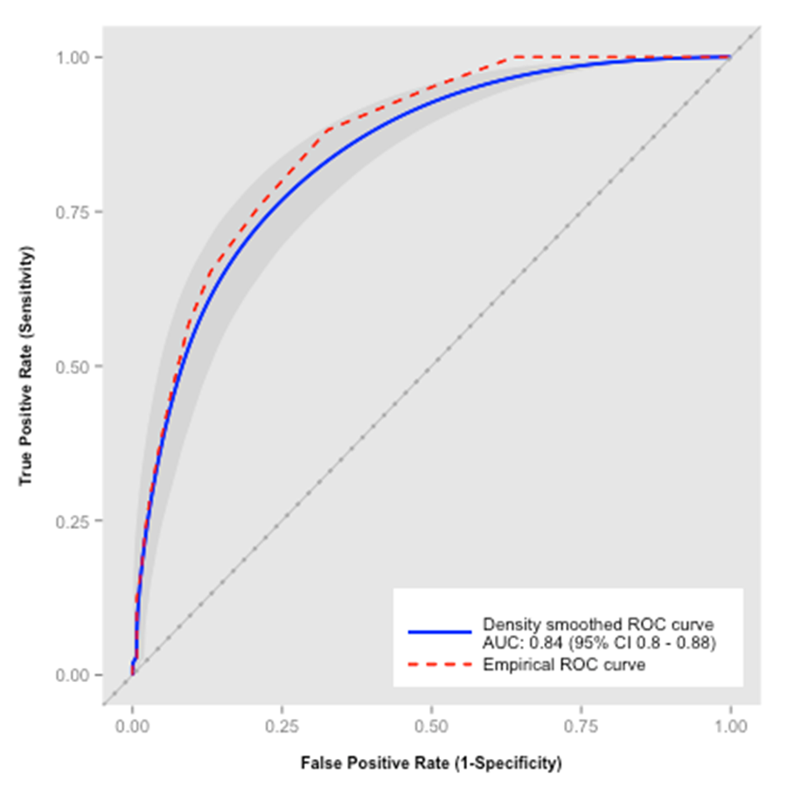
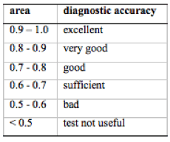
Results 1 Area Under the Curve (AUC)
ROC Plot with 95% Confidence Region:
Predicting Hazardous Drinking with AUDIT score (females aged 18-35)
Notes:
http://www.ifcc.org/ifcc-communications-publications-division-%28cpd%29/ifcc-publications/ejifcc-%28journal%29/e-journal-volumes/ejifcc-2008-vol-19/vol-19-no-4/measures-of-diagnostic-accuracy-basic-definitions/
The International Federation of Clinical Chemistry and Laboratory Medicine
eJIFCC - The electronic Journal of the International Federation of Clinical Chemistry and Laboratory Medicine

Slide 10
Conclusion 1
Overall, AUDIT showed good or very good accuracy for all outcome measures for young adult males and females, except for alcohol abuse which had sufficient accuracy

Slide 11
Results 2 Thresholds
ROC Plot with 95% Confidence Region:
Predicting Hazardous Drinking with AUDIT score (females aged 18-35)

Slide 12
Results 2 Thresholds
Optimal cut-points for AUDIT as a predictor of hazardous drinking, alcohol abuse, alcohol dependence and alcohol use disorders in males and females, according to unweighted and weighted Youden J statistic

Slide 13
Results 2 Thresholds
Optimal cut-points for AUDIT as a predictor of hazardous drinking, alcohol abuse, alcohol dependence and alcohol use disorders in males and females, according to unweighted and weighted Youden J statistic

Slide 14
Results 2 Thresholds
Optimal cut-points for AUDIT as a predictor of hazardous drinking, alcohol abuse, alcohol dependence and alcohol use disorders in males and females, according to unweighted and weighted Youden J statistic

Slide 15
Conclusions 1-2
Overall, AUDIT showed good or very good accuracy for all outcome measures for young adult males and females, except for alcohol abuse which had sufficient accuracy
In a screening scenario where sensitivity might be prioritized, the optimal cut-point threshold is lower than established AUDIT cut-point thresholds of 8+ for men and 6+ for women

Slide 16
An alternative to single cut-off thresholds
G.H. Hall wrote in the Lancet (1975):
    “It is time that we abandoned the use of fixed levels of sensitivity and specificity…There is no need to use a single cut-off point between normality and disease”
Bayes’ Theorem uses pre-test information (e.g. patient characteristics, disease prevalence) and combines this with test information (likelihood ratio) to provide a post-test probability estimate that a patients has the condition
So, a probability (or “risk”) estimate can be specified for each point on a test score. This can be presented as a probability graph (Katz) or nomogram (Fagan)

Slide 17
Results 3 Probability Graphs
Bayes’ Theorem post-test probability estimates for drinking problems in English females aged 18-35, according to AUDIT score

Slide 18
Conclusions 1-2-3
Overall, AUDIT showed good or very good accuracy for all outcome measures for young adult males and females, except for alcohol abuse which had sufficient accuracy
In a screening scenario where sensitivity might be prioritized, the optimal cut-point threshold is lower than established AUDIT cut-point thresholds of 8+ for men and 6+ for women
Bayes’ Theorem to calculate individual probabilities for problem drinking offers an alternative to arbitrary cut-point threshold scores in screening and brief intervention programmes

Slide 19
Broader context
AUDIT can be a valid test for women and younger adults, but latest evidence for brief interventions is not so good, e.g.
  Cochrane review / trials of brief interventions in primary care and other settings
  Cochrane review / trials of motivational interviewing
  Cochrane review / trials of social normative feedback
Evidence suggests that giving information as universal, selective, or indicated prevention is, on its own, generally ineffective

Slide 20
Form and Function in a prevention matrix

Slide 21
AUDIT Haiku
Study shows AUDIT
Is good for younger women
But cut point fog
Bayes might just offer
Sunny option only if
Information works

Slide 22
Optimistic...
We’re making scientific progress on prevention effectiveness…and it’s pointing to the need for more scientific effort to evaluate the effectiveness of:
  (i) demand reduction interventions that are easy to scale up, even if effect sizes are relatively small;
  (ii) supply side (environmental) prevention; and
  (iii) prevention systems that combine different forms and functions of prevention
Even if informational approaches are ineffective for behaviour change, there should be a public discourse about the values a Society attaches to the public and personal provision of health information

Slide 23
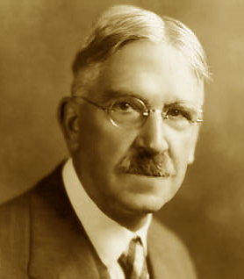
Three main tenets of John Dewey’s social philosophy
that a scientific approach is a characteristic of a mature democracy
that the role of the public in policy making is brought to the fore
that education is an important vehicle for social change

