Slide 1

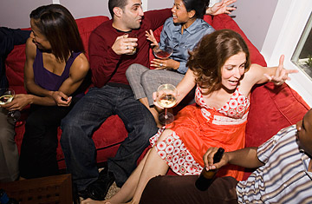
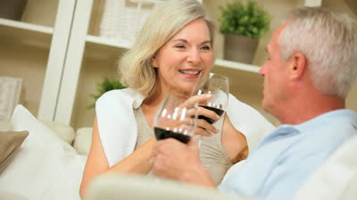
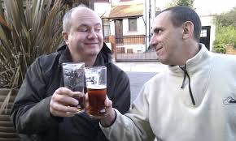
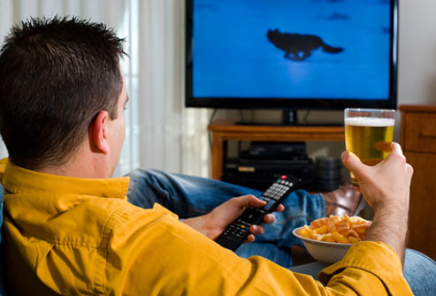
A new approach to measuring drinking occasions in Britain
John Holmes
Melanie Lovatt
Abdallah Ally
Sheffield Alcohol Research Group,
ScHARR, University of Sheffield
Funder: Alcohol Research UK

Slide 2
Culture in the 2012 Alcohol Strategy
“A culture where it has become acceptable to be excessively drunk in public.”
“The vibrant café culture… failed to materialise.”
“Changing the drinking culture from one of excess to one of responsibility… from one where alcohol is linked to bad behaviour to one where it is linked to positive socialising.”
“Local communities, services and businesses are best-placed… to develop the culture that they want.”
“The alcohol industry has adopted a core commitment to foster a culture of responsible drinking which will help people drink within the guidelines.”

Slide 3
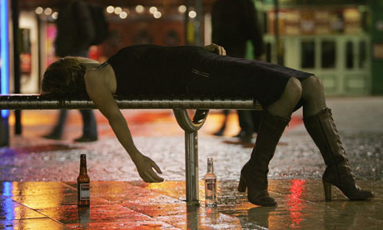
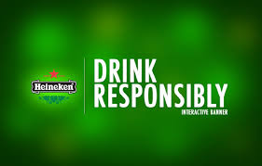
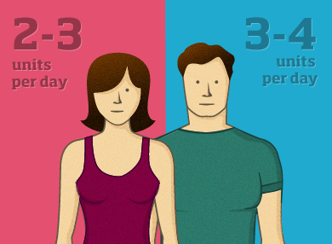
Culture in alcohol policy
Policy debate defined culture through:
  Crude caricatures
  Vague concepts
  Narrow metrics
No evidence of systematic consideration given to:
  What the drinking culture is
  What we want it to be
  How policy interacts with different aspects of culture

Slide 4
Project aims
Access culture through key concept of drinking occasions with a view to:
  Develop typological models to quantitatively describe British drinking occasions
  Explore how occasions vary across population subgroups
  Validate typologies with qualitative data

Slide 5
Methods

Slide 6
Data
Market research data from Kantar:
  Weekly alcohol consumption diary (sampled all year round)
  2009-2011 (cross-sectional)
  30,000 respondents per year
  60,609 drunk in diary week

Slide 7
Variables in the dataset
Occasion characteristics
Day, time and duration | Who with (sex, relationship)
Location (type and urbanity) | Motivation and Reason
Quantity consumed | Type of drink
Spend on alcohol (weak) | Spend on food (weak)
Gender | Age
Socioeconomics | Household structure
Ethnicity | UK region
Notes:
Give examples where the information is ambiguous

Slide 8
Analysis
Define occasion as: ‘no two-hour gap between drinks’
Typology constructed using Latent Class Analysis:
  Proportion of occasions of each type
  Probability a given type has a given characteristic
  Probabilistic not deterministic typologising of occasions

Slide 9
Analysis
Typologies constructed for:
  Population as a whole
  Subgroups defined by:
    Age
    Gender
    Socioeconomic status
Occasion types = 8
  Pragmatic rather than goodness of fit decision
Focus groups with drinkers used to validate findings

Slide 10
Results

Slide 11
Population summary
Mixed on/off-trade heavy drinking occasions 10% | Sharing a bottle (or two) at home with partner 9% | Drinks with family/ friends at someone’s house 14% | Heavy on-trade drinks with friends 11%
Family outing to a restaurant(?) 9% | Quiet drink at home alone 14% | Quiet drink at home with partner 20% | Quiet drink at home with family 13%
Notes:
Emphasise:
Banality of much of these – there’s nothing that looks like a heavy night out (although talk later about looking specifically at young people) – maybe there is simply too much variation in occasions that this ten-type model can’t capture some of the more spectacular but less frequent events.
The off-trade focus (purple)
Distinguishing feature of many occasions (in this early look at the results) seems to be more the when and why rather than the who, where or how much.

Slide 12
Example: Sharing a bottle (or two) at home with partner
Characteristic | Response | P (Response)
Company* | Spouse or partner | 0.84
Beverage* | Off-trade wine | 0.70
Location* | My own home | 0.97
Motivation* | Wind down or chill out | 0.49
 | Spend quality time with someone special | 0.25
Occasion* | Regular/everyday drink | 0.21
 | Staying in as a couple | 0.32
 | Quiet night in | 0.31
Day | Monday-Thursday | 0.35
 | Friday-Saturday | 0.45
 | Sunday | 0.19
Duration | 1-3 Hours | 0.60
Consumption | Binge (6/8 units to 12/16 units) | 0.81
 | Heavy binge (more than 12/16 units) | 0.19
* Multiple responses permitted

Slide 13
Summary: Under-35 males in lower socioeconomic groups
Drinks with family/friends at someone’s house 12% | Night out with pre-loading 16% | Weekend night out with friends 15% | Quiet night in with family 7%
Regular home drinking with partner 11% | Quiet drink at home alone 13% | Light drinks at someone’s house 14% | Light on-trade drinking (misc.) 12%
Notes:
Emphasise:
Banality of much of these – there’s nothing that looks like a heavy night out (although talk later about looking specifically at young people) – maybe there is simply too much variation in occasions that this ten-type model can’t capture some of the more spectacular but less frequent events.
The off-trade focus (purple)
Distinguishing feature of many occasions (in this early look at the results) seems to be more the when and why rather than the who, where or how much.

Slide 14
Heavy drinking occasions by age
Under-35s
35 and older
Few drinks during night in with partner
Nights out with pre-loading
Miscellaneous mixed occasions
Few drinks with family/friends at someone’s house
Nights out without pre-loading
Few drinks at the local

Slide 15
A new framework for policy analysis
What don’t you like about the drinking culture?
What would your desired typology of occasions look like?
Which occasions is your policy designed to affect and what are your priorities?
Does existing evidence support this claim?
How has the typology changed as consumption changes?

Slide 16
Conclusions
Systematic characterisation of drinking cultures is lacking in research and policy
Typological models can be developed which provide an empirical characterisation
Such models provide a framework for policy analysis

Slide 17
Further information
Email: john.holmes@sheffield.ac.uk
Website: Google: Sheffield Alcohol Research Group
Twitter: @ScHARRpubhealth & @JHolmesSheff

Slide 18
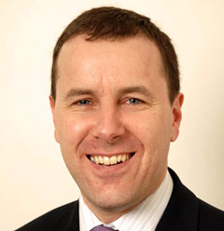
Andrew Opie
British Retail Consortium
“Irresponsible drinking has cultural causes...It’s a myth to suggest supermarkets are the problem . Effectively a minimum price is a tax on responsible drinkers”

Slide 19
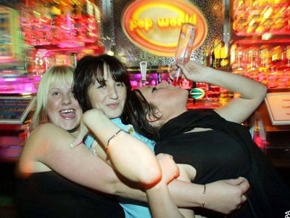
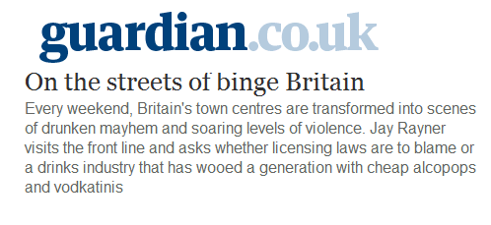
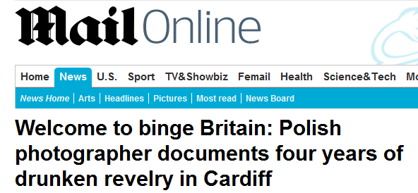
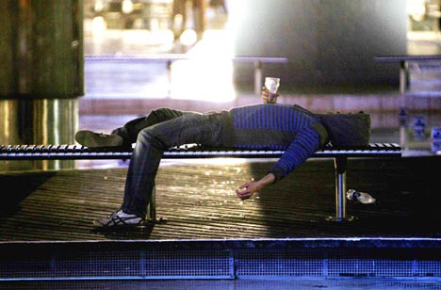
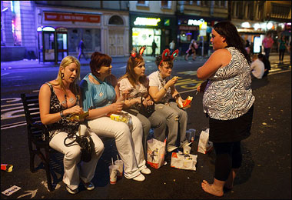
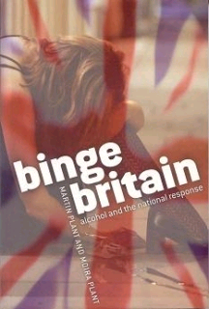
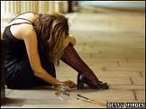
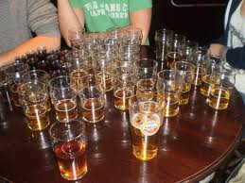
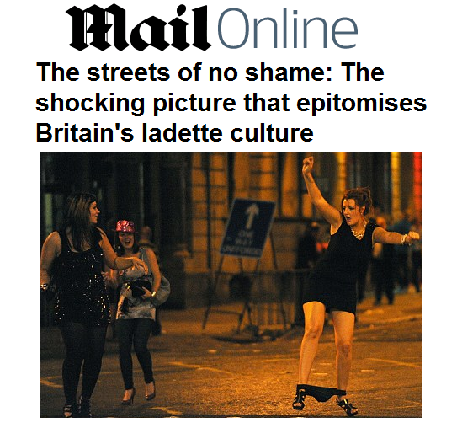
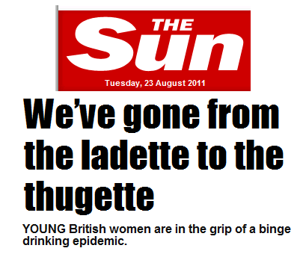
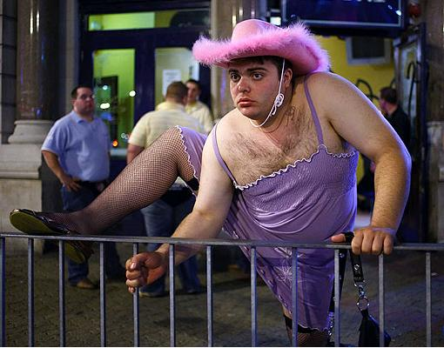
Culture in public debate
Notes:
Street drinking
Women
Chronic heavy drinkers don’t get a look-in

Slide 20
Example 2: Quiet drink alone at home
Characteristic | Response | P (Response)
Company* | Alone | 1.00
Beverage* | Off-trade wine | 0.41
 | Off-trade beer | 0.32
 | Off-trade spirits | 0.23
Location* | My own home | 0.99
Motivation* | Wind down or chill out | 0.45
Occasion* | Quiet night in | 0.35
 | Regular/everyday drink | 0.25
Day | Monday-Thursday | 0.51
 | Friday-Saturday | 0.34
 | Sunday | 0.14
Duration | Less than an hour | 0.50
 | 1-3 hours | 0.40
Consumption | Not a binge (less than 6/8 units) | 0.80
* Multiple responses permitted

Slide 21
Latent class analysis
LCA gives two main pieces of information:
  Latent class probability: The proportion of occasions within each ‘type’
  Conditional probability: Given an occasion is of Type x, the probability that it has a given characteristic
LCA is probabilistic not deterministic
  Occasions are not assigned to types (although this can be done using modal probabilities)

Slide 22
Latent Class Analysis
LCA models the intercorrelation between observed variables as explained by an unobserved latent variable
A
A
B
B
X
C
C
D
D
Notes:
Suppose the variables ABCD are characteristics of a given drinking occasions (i.e. things like who people are drinking with, where they are drinking and how much they drink). All of those things are likely to be stiastically correlated with each other – as you can see in the diagram. By using LCA, you assume all of that intercorrelation is explained by the observed variables’ relationship to a latent (or unobserved) categorical variable. In our case, this latent variable is the type of drinking occasion.
So what you are trying to do is use the observed data you have to create a description of the different categories or types of drinking occasions within that latent variable.

Slide 23
Why does this matter?
“SAB Miller sees female drinkers as a key beneficiary of its wider bid to attract more consumers on more occasions through a mix of innovation, packaging and advertising.
Future attempts will revolve around…marketing that pushes six distinctive experiences: family occasions such as BBQs, mixed gender casual parties, mixed gender casual meals, mixed gender evening meals, colleagues socialising and men together in bars”
Marketing Week, 7th October 2014

Slide 24
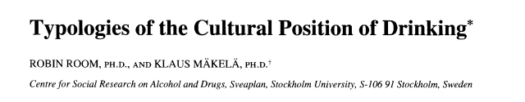
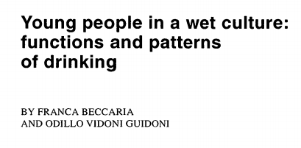
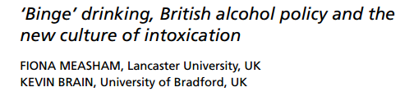
Research on drinking cultures
Typically:
  Qualitative not quantitative
  Homogeneous national cultures not heterogeneous subcultures
  Addresses the spectacle not the mundane

