Slide 1
Improving the management of comorbid addictive and mental disorders through the use of technology
Associate Professor Frances Kay-Lambkin
National Drug and Alcohol Research Centre, University of New South Wales, AUSTRALIA

Slide 2
Funding declarations
National Health and Medical Research Council (project grant, fellowship support, Centre for Research Excellence).
My work is the subject of publishing contracts with multiple companies, including CCBT Ltd in the EU, Magelan, multiple BCBSs and Cobalt Therapeutics LLC in the US, as well as the NHS in the UK. Although I have received no remuneration to date, I may receive royalties in the future. I have not received any equity or payments related to the work discussed in the above presentation.

Slide 3
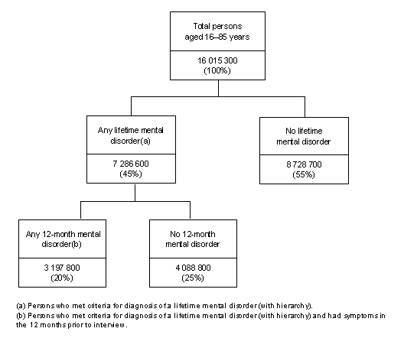
The mental health of Australians
NSMHWB (2007)
Notes:
16 millions Australians aged 18-85, almost half had a lifetime mental disorder – 1 in 5 in the past 12 months
14% had a 12-month anxiety disorder
6% had a 12-month depression
5% had a 12-month substance use disorder

Slide 4
Comorbidity is the rule
25-50% of people experience comorbidity
>1 mental disorder
One mental disorder and 1+ physical conditions
Every year, approx. 340,000 Australians experience the combination of a mental health and alcohol/other drug problem
Excluding tobacco alone
Increasing by approx. 10% annually
AIHW (2012) Comorbidity of mental disorders & physical conditions
Sacks et al. (2013) J Substance Ab Treat, 44: 48-493
Rush (2007) Am J Psychiatry, 164(2): 201-204
Notes:
AIHW 2012
We are yet to understand the exact mechanisms underlying the comorbidity between mental disorders –
Notwithstanding these debates..what we DO know is that comorbid mental health and addictive disorders have overlapping genetic vulnerablilities, overlapping environmental triggers(stress, trauma, early exposure to drugs), they involve similar brain regions and are both developmental disorders beginning in adolscence or even childhood.

Slide 5
Comorbidity
Poorer treatment outcomes
Prognosis, response, chronicity, relapse
Addictive substances exacerbate psychiatric symptoms
People with mental health problems may continue to use psychoactive drugs to attenuate psychiatric symptoms
Active use of substances can substantially interfere with psychiatric pharmacotherapies
Frei & Clarke (2011). Medical J Aust 195(3): S5-S6.
Notes:
comorbidity increases treatment seeking efforts, but there is considerable unmet need in this population [2], and difficulties with treatment access. It is generally the more severe cases with multiple co-morbid disorders and distress who receive treatment, but even in these cases co-morbid disorders are frequently not diagnosed or treated. (hall, 1996)
People with co-occurring disorders often exhibit more symptoms than those cause by either disorder alone.
And even in people whose comorbidities do not occur simultaneously, research suggests that mental disorders can increase vulnerability to subsequent addictive disorders, and the addiction constitutes a risk factor for subsequent mental disorder.
Once accepted into treatment, people with comorbid MHSUP who engage with mental health services report poorer treatment outcomes [10, 44], most likely accounted for by a more complex clinical profile at presentation that mediates treatment engagement and response

Slide 6
Comorbidity is the rule in clinical practice… however… Comorbidity treatment research is the exception…
Notes:
Descriptive and epidemiological research common
Treatment research – well conducted, RCTs – rare
But – Australia leads the world in this space

Slide 7
Treatment for comorbid disorders
Australian treatment silos:
High-prevalence mental disorders + alcohol/other drug disorders = Substance Use Agencies.
Low-prevalence mental disorders = Mental Health Services.
Similar systemic and clinical barriers impede integration of care internationally:
44% of people with comorbid disorders receive treatment for either disorder, and only 7% receive treatment for both disorders.
Sacks et al. (2013) J Substance Ab Treat, 44: 48-493
Frei & Clarke (2011). Medical J Aust 195(3): S5-S6

Slide 8
The potential of e-health to respond...
E-health = rapidly expanding field of health information and communication technology.
Widespread recognition within health sector that better use of e-health initiatives should play a critical role in improving the healthcare system.
Increasing acceptance for individuals to take a more active role in protecting their health and participating in their own health care.
Notes:
Economically viable solutions must emphasize peer support,
family support, self-help, and technology. Self-help programs
for people with mental health problems are expanding more rapidly than professionally
delivered care, are clearly useful to many people, and have the
great advantage of allowing geometric growth without greatly
increasing costs
Our team has been one of the first to demonstrate that integrated treatments are able to be delivered to people with comorbid psychosis and tobacco addiction via telephone, and for depression and alcohol or cannabis addiction (with minimal therapist assistance, and certainly not specialist assistance).

Slide 9
Access to technology… bridging the digital divide
 | Gen Pop | Mild Dep | Mod-Sev Dep | Risky Drink | Harmful Drink | Psychosis | PTSD + AOD
Mobile | 44% | 34% | 37% | 46% | 41% | 34% | 34%
Mobile with Internet | 22% | 23% | 30% | 21% | 41% | 30% | 48%
Internet | 84% | 84% | 79% | 87% | 100% | 65% | 66%
Gen Pop=General Population (N=894) – no MH/AOD
Mild Dep=PHQ-9 score 5-9 (N=188)
Mod-Sev Dep=PHQ-9 score ≥ 10 (N=67)
Risky Drink=AUDIT score 8-15 (N=135)
Harmful Drink=AUDIT score ≥ 16 (N=22)
Psychosis=Current diagnosis (N=115)
PTSD+AOD=Current AOD treatment (N=29)
Notes:
Consider that, on average,89% of Aust population report Internet usage …

Slide 10
Does eHealth deliver for comorbidity?

Slide 11
Notes:
Interactive
– video case vignettes to discuss skill development, homework implementation, encouragement
handouts/information sheets to print out and complete in session (and for homework)
Some choice of the pathway through the module (goal setting re: AOD use, motivational pathways)
Clinician assistance
“Check-in” sessions
Suicide/mood assessment
Plan for completing homework
Make next appointment
Occurred at the conclusion of therapist-delivered and SHADE sessions
Manualized, tape recorded and timed
SHADE check-in sessions averaged 16 minutes per week
Nurses social workers mental health workers, etc,
No CBT training required
Brief checks only - work in your usual way with clients, but deliver specialised treatment package
Role consists of monitoring clinical symptoms (suicidality, risk assessments), as a motivator to do their homework, and to be a problem solver (if patient doesn’t do homework, the coach can inquire as to why that was, and help them to overcome that for the next week).

Slide 12
SHADE 1.0
Assessed for eligibility (n=169)
Excluded (n=72)
Not meeting inclusion criteria (n=44)
Refused to participate (n=19)
Other reasons (n=9)
Eligible to enter trial (n=97)
Initial Assessment (n=97)
Brief Intervention (1 session with therapist, n=97)
Random Allocation (n=97)
9 further sessions therapist-delivered MI/CBT
9 further sessions of computer-assisted MI/CBT
No further treatment
Post-treatment assessment (3, 6, 12 months)
Notes:
Describe randomization sequence…an independent research manager generated the randomization sequence for study participants according to their unique study identifier. Treatment was allocated using permuted blocks of varying sizes (in multiples of 3) to reduce potential for guessing. Randomization was stratified for gender, antidepressant medication (yes/no)and pharmacotherapy for alcohol/other drug use (yes/no). The research manager provided clinicians with the participant’s concealed randomisation code immediately prior to the first session of treatment with that participant. The first session was conducted blind to allocation (both therapist and participant), until the conclusion of the session when the envelope was opened by the participant.

Slide 13
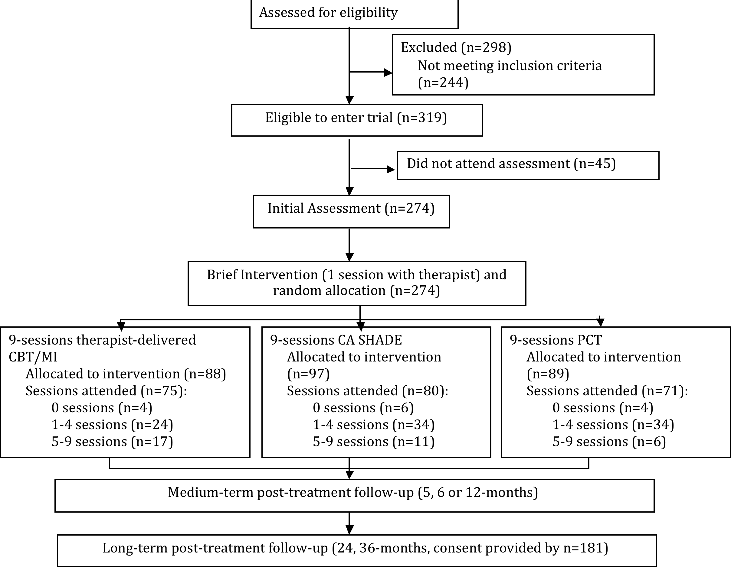
SHADE 2.0
Medium-term post-treatment follow-up (3, 6 or 12-months)
Notes:
Describe randomization sequence…an independent research manager generated the randomization sequence for study participants according to their unique study identifier. Treatment was allocated using permuted blocks of varying sizes (in multiples of 3) to reduce potential for guessing. Randomization was stratified for gender, antidepressant medication (yes/no)and pharmacotherapy for alcohol/other drug use (yes/no). The research manager provided clinicians with the participant’s concealed randomisation code immediately prior to the first session of treatment with that participant. The first session was conducted blind to allocation (both therapist and participant), until the conclusion of the session when the envelope was opened by the participant.

Slide 14
Retention in Treatment and F-up
Study Phase | N (%) Retained
Baseline | 274/274 (100%)
Treatment (10 sessions) Therapist MI/CBT Computer-assisted MI/CBT (SHADE) Person-centered therapy | 30/88 (41%, mean=6.12, SE=.44) 29/97 (36%, mean=5.28, SE=.44) 27/89 (31%, mean=5.58, SE=.48)
3 months post-treatment | 163/274 (60%)
6 months post-treatment | 166/274 (60%)
12 months post-treatment | 164/274 (60%)
24 months post-treatment | 116/274 (42%)
36 months post-treatment | 88/274 (32%)
At least one medium-term follow-up | 205/274 (75%)
At least one long-term follow-up | 134/274 (49%)

Slide 15
Clinician contact + preference
Clinician contact
SHADE computerized therapy: 64mins + 16mins/wk
Therapist-delivered CBT/MI: 64mins + 58mins/wk
PCT: 64mins + 41mins/wk
Treatment preference = 148 (55%)
Therapist = 133; Computer = 15
Not related to treatment outcome
Treatment preference matched allocation = 92 (37%)
Not related to treatment outcome

Slide 16
Demographics (N=274)
Males 57%
Mean Age 40 yrs
Education
Age at leaving school 16 yrs
Employment Status
Employed at least part-time 42%
Disability benefit 20%
Unemployment benefit 24%
Primacy
Depression 54%
Substance use 16%
Inter-related 30%
Not related to treatment outcome

Slide 17
BDI-II (N=134)
ES (b-36/12)
TH=1.52
SHADE=1.38
PCT=1.28

Slide 18
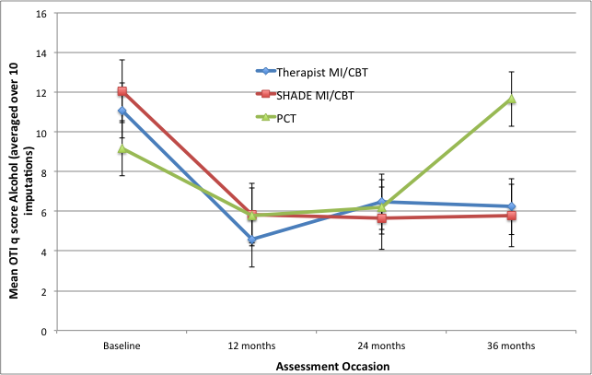
Alcohol (n=88)
ES (b-36/12)
TH=0.48
SHADE=0.62
PCT=-0.24

Slide 19
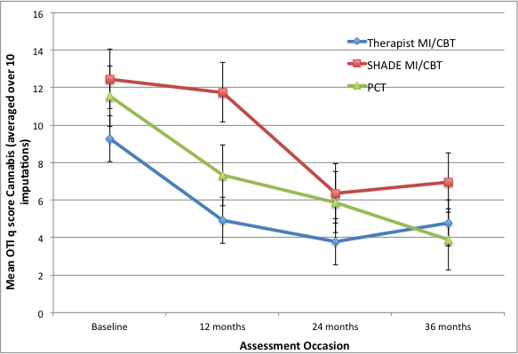
Cannabis (n=52)
ES (b-36/12)
TH=0.36
SHADE=0.44
PCT=0.61

Slide 20
SHADE 1.0 & 2.0 Synthesis
Clinician-assisted SHADE treatment promising
Uses at least 50% less clinician time to produce similar, sustained reductions in depression, alcohol, cannabis use
Some suggestion that cannabis use is more responsive to non face-to-face intervention

Slide 21
Acceptability
Treatment attendance and follow-up retention:
No significant differences between therapist and SHADE.
Therapeutic Alliance (ARM, Sessions 1, 5, 10):
No significant differences between therapist and SHADE for bond, openness, confidence.
Client Initiative
Session 1: SHADE>Therapist
Session 5: SHADE>Therapist
Kay-Lambkin et al. (2011), J Med Internet Res 13(1): e11

Slide 22
The vital piece in the puzzle….
The Clinician!
Internet treatment a useful step within a larger therapeutic process:
Delegation of routine clinical tasks (sub-contract);
Clinician “extender” (offer as homework, extending expertise, offer integrated treatment);
Extend benefits of treatment;
Prevention and early intervention;
Introduction to treatment (wait-lists);
Relapse prevention following treatment.
Carroll & Rounsaville (2010) Current Psychiatry Reports 12: 426-432
Notes:
Increase adherence to evidence-based practice
Empower clients to become more active agents in their own care
Free up clinician time and resources
Cost effective provision of high quality, high fidelity treatment – even for comorbid disorders

Slide 23
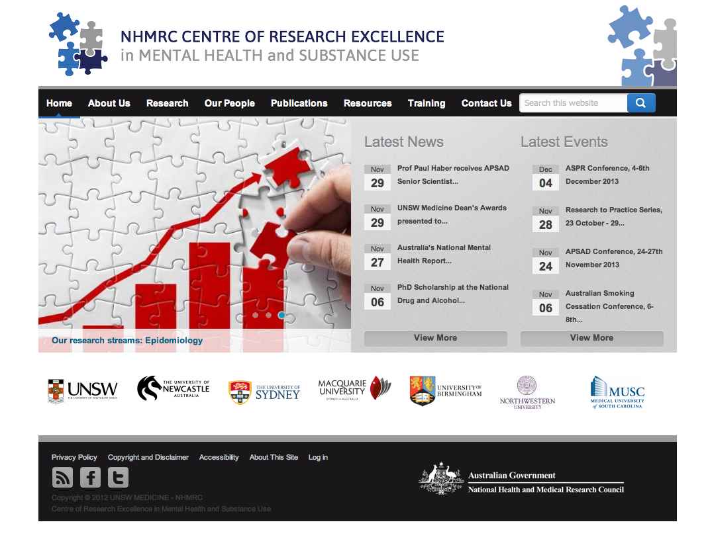
www.comorbidity.edu.au
Notes:
Resources available to clinicians and researchers to encourage work in this area… this include evidence-based assessment packages, treatment resources, and links to our online programs/research.
We would love to see you there and work together with you on this important public health problem.

Slide 24
Acknowledgements
Amanda Baker
Maree Teesson
David Kavanagh
Brian Kelly
Terry Lewin
Vaughan Carr
Funding
AERF
NHMRC
DoHA
Institutions
f.kaylambkin@unsw.edu.au @FranKayLamb

